Slide 1




Alterations in microbial interaction networks in multiple sclerosis
Research Team : Study and manipulation of tolerance in human immunopathology (Guy Gorochov)
Supervisor : Lejla Imamovic, Research Scientist
By Simeon Nthuku
June 15th 2023

Slide 2
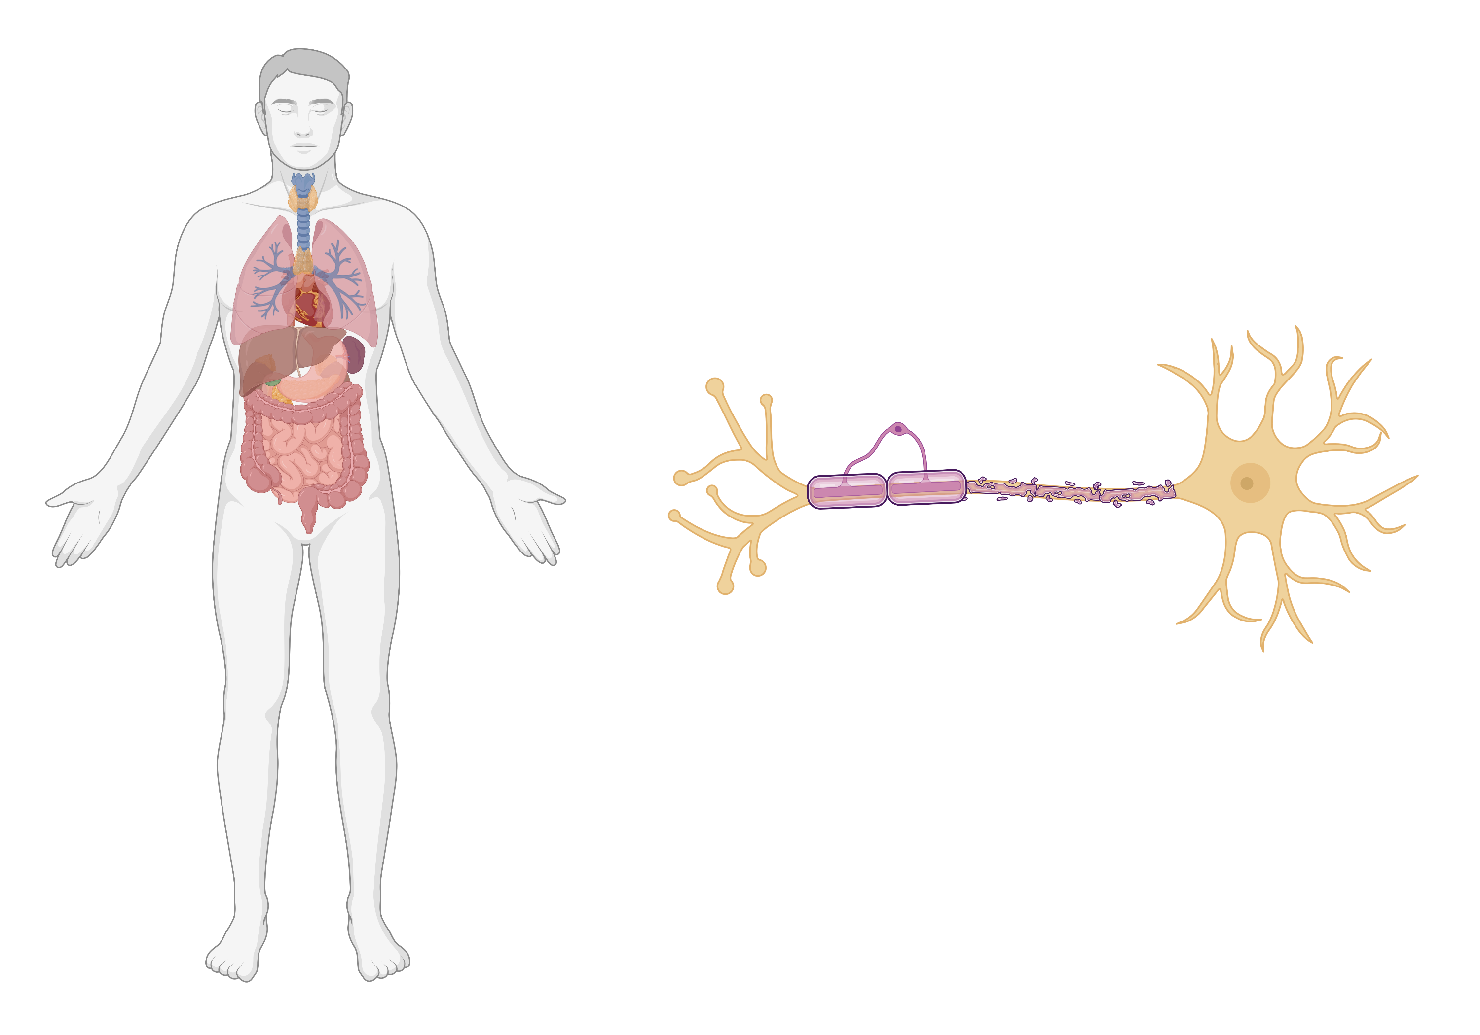
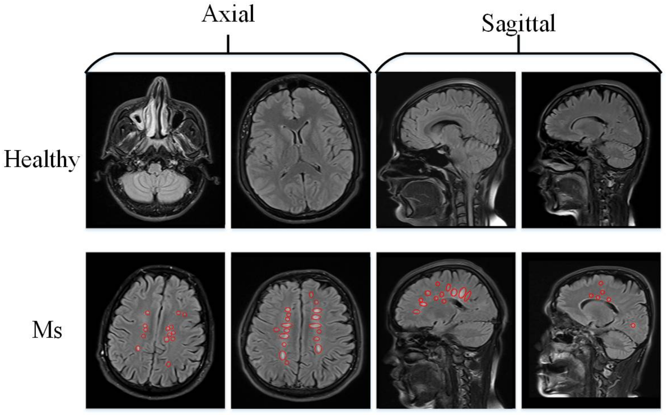
Multiple sclerosis (MS), a chronic neurological disorder
- A heterogenous autoimmune demyelinating
disorder of the central nervous system.
- Around 2.8 million people are estimated to live with MS worldwide (Walton et al., 2020)
Myelin sheath breakdown
Clinical development
Clinically
Isolated
Syndrome
(CIS)
20-80% of patients
Progressive
MS
?
Drivers of disease progression
Early acute onset
of MS
Late chronic MS
(Macin et al., 2020)
1

Slide 3
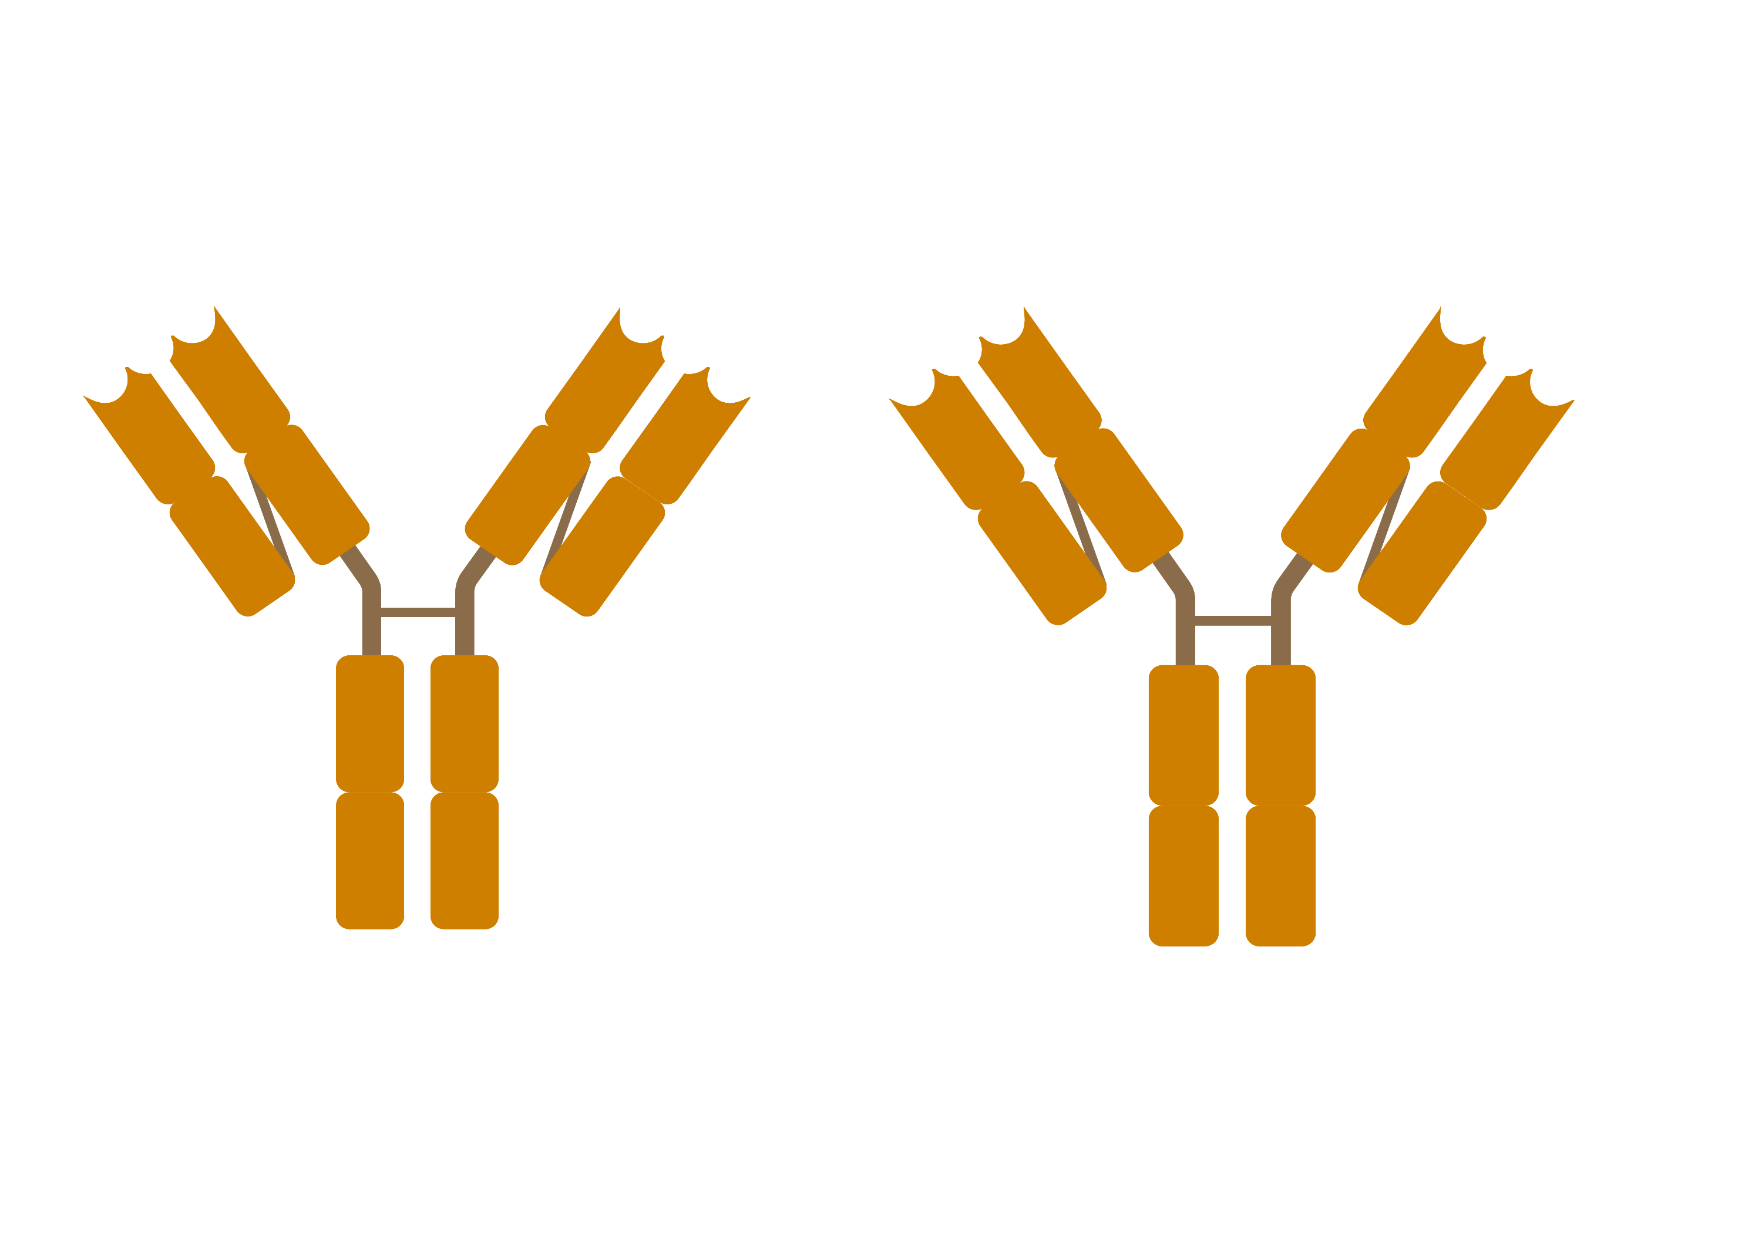
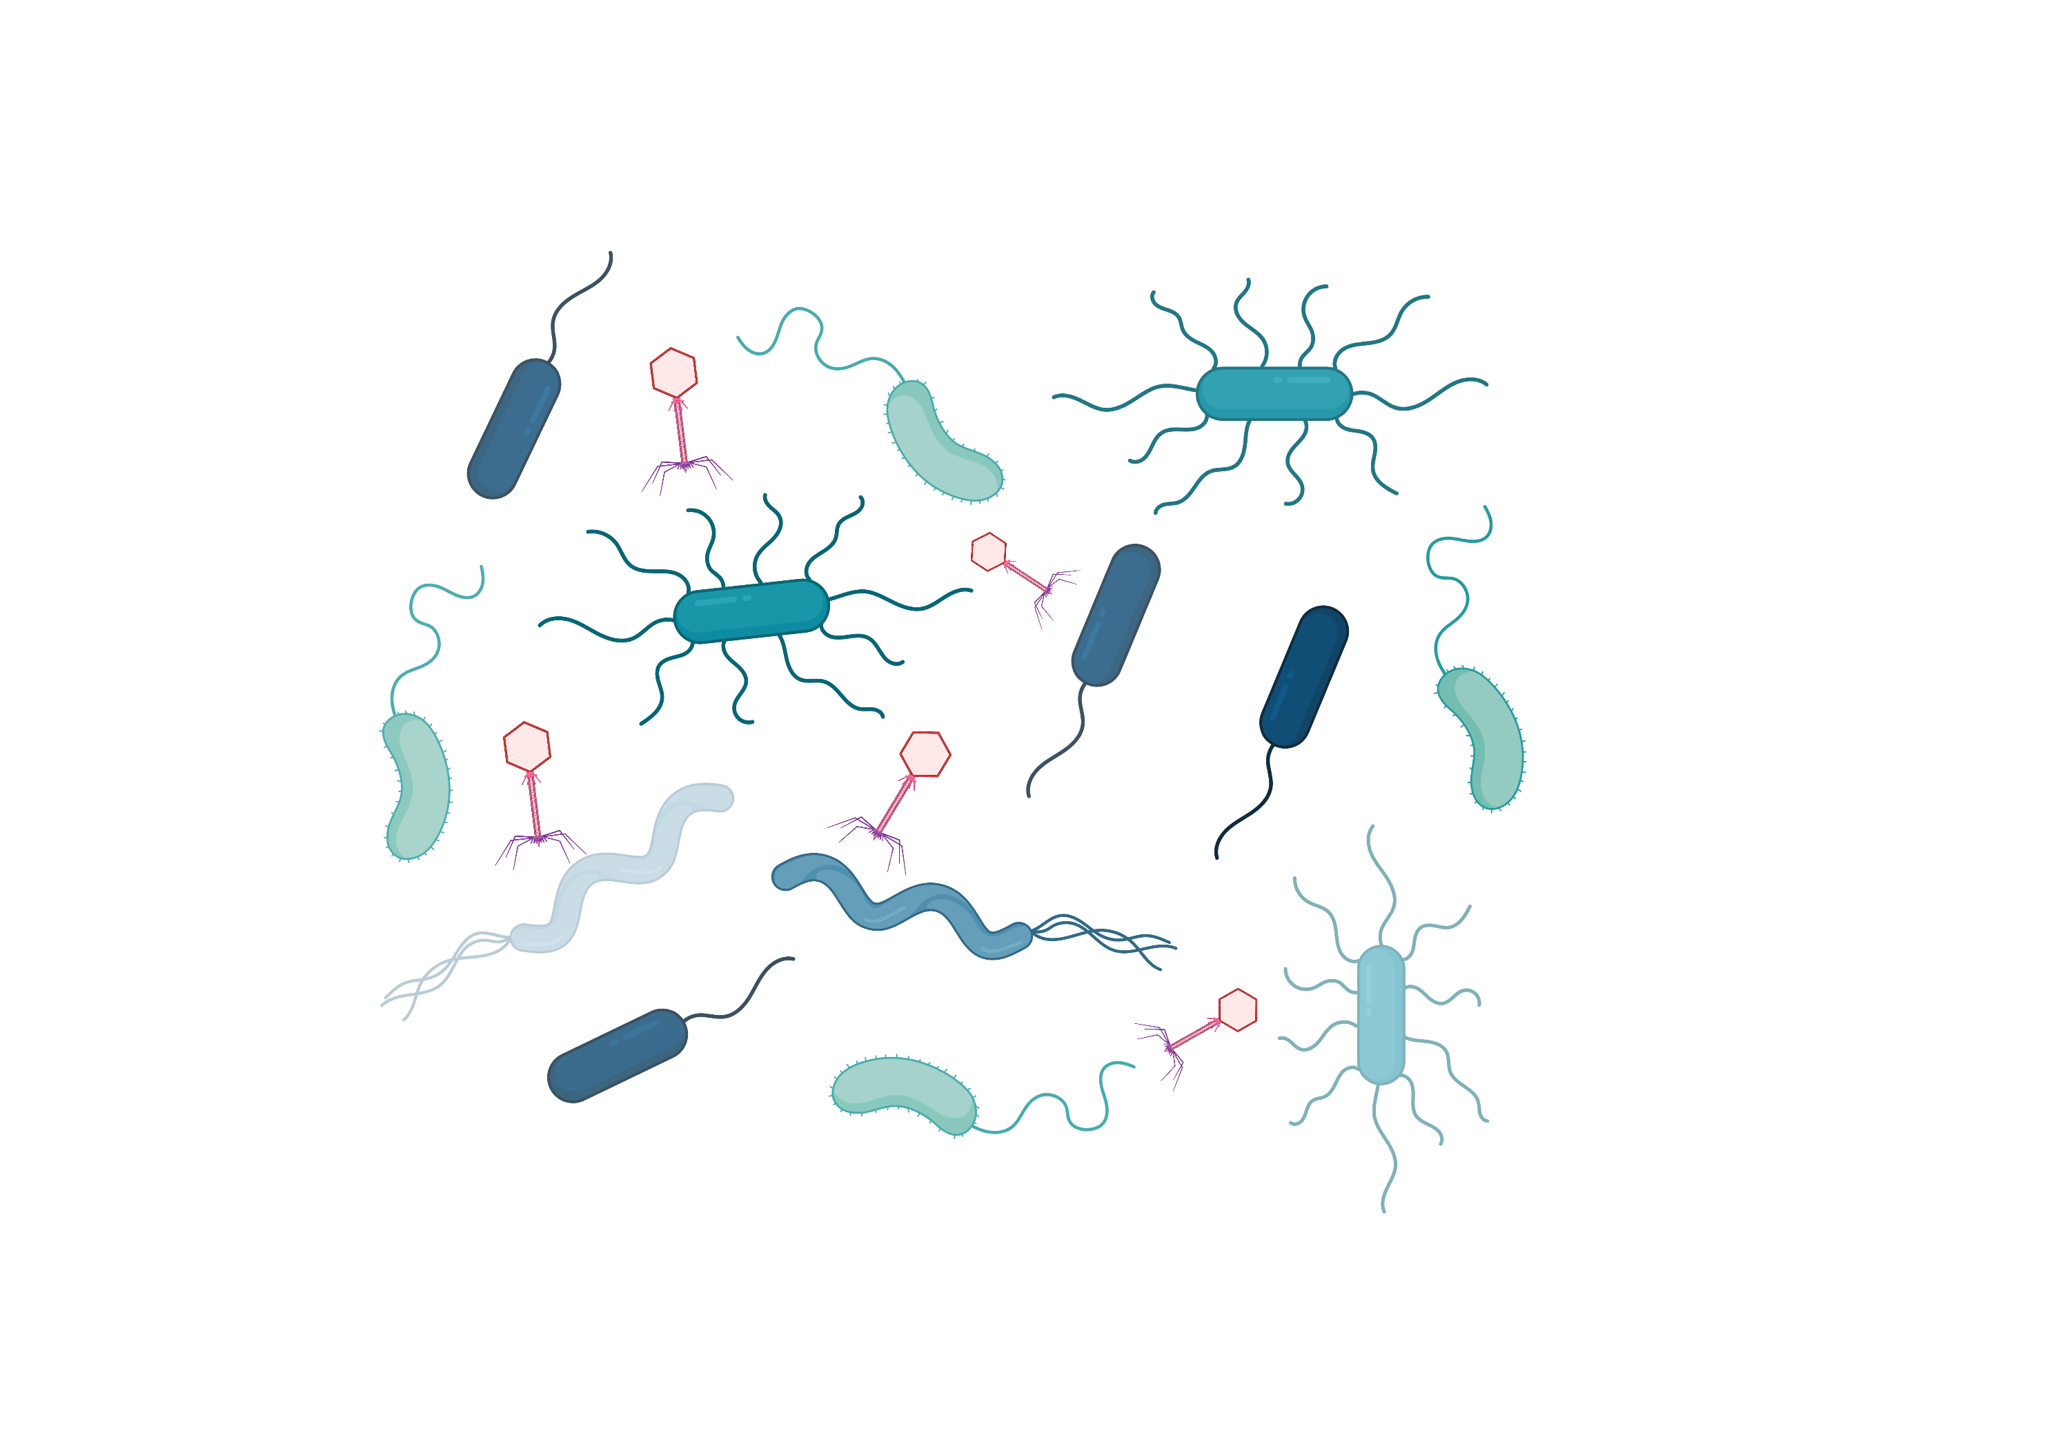
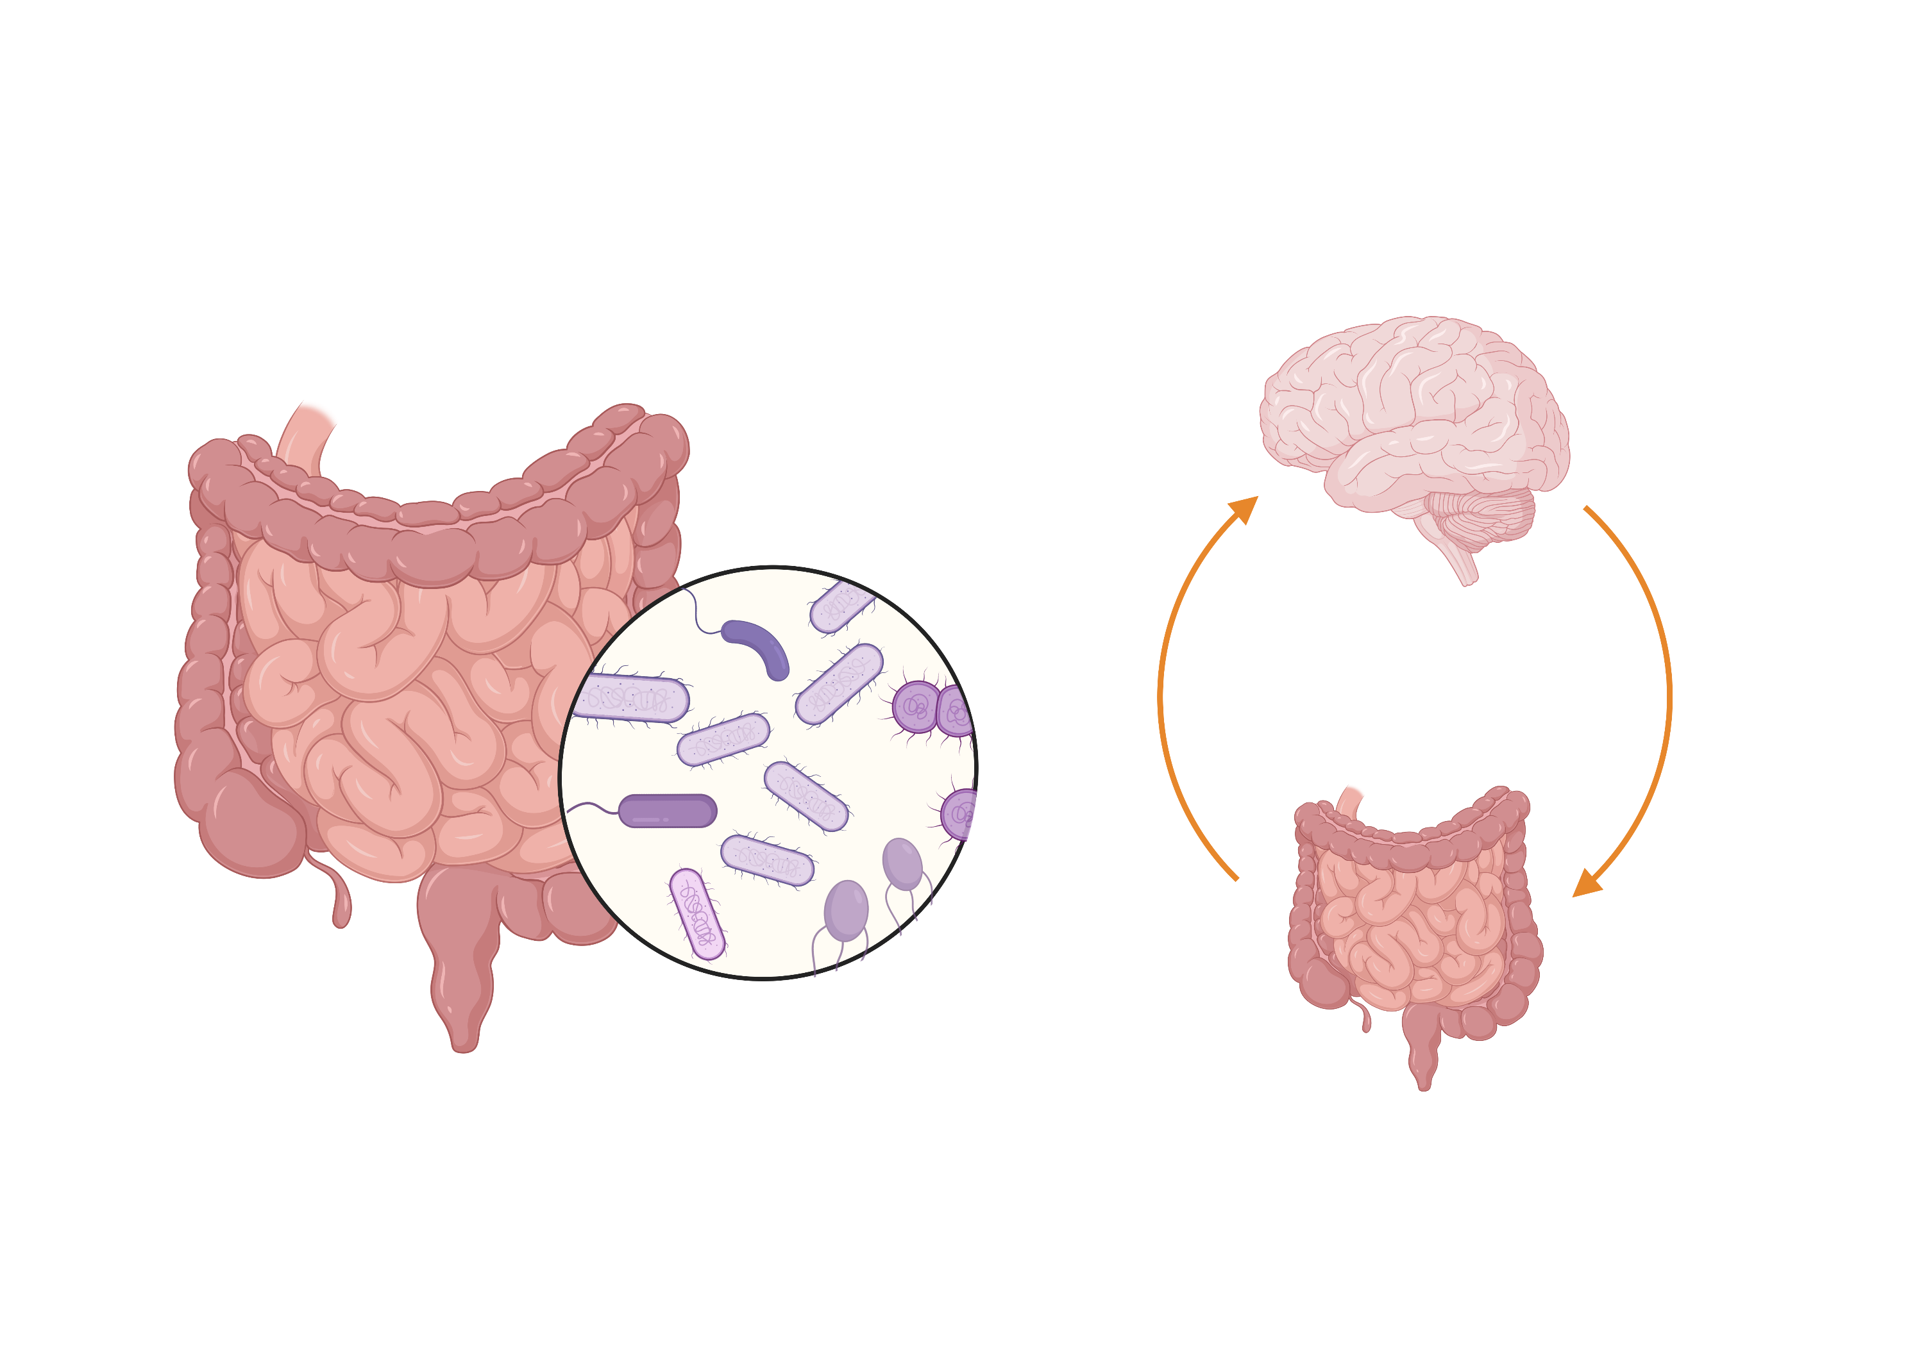
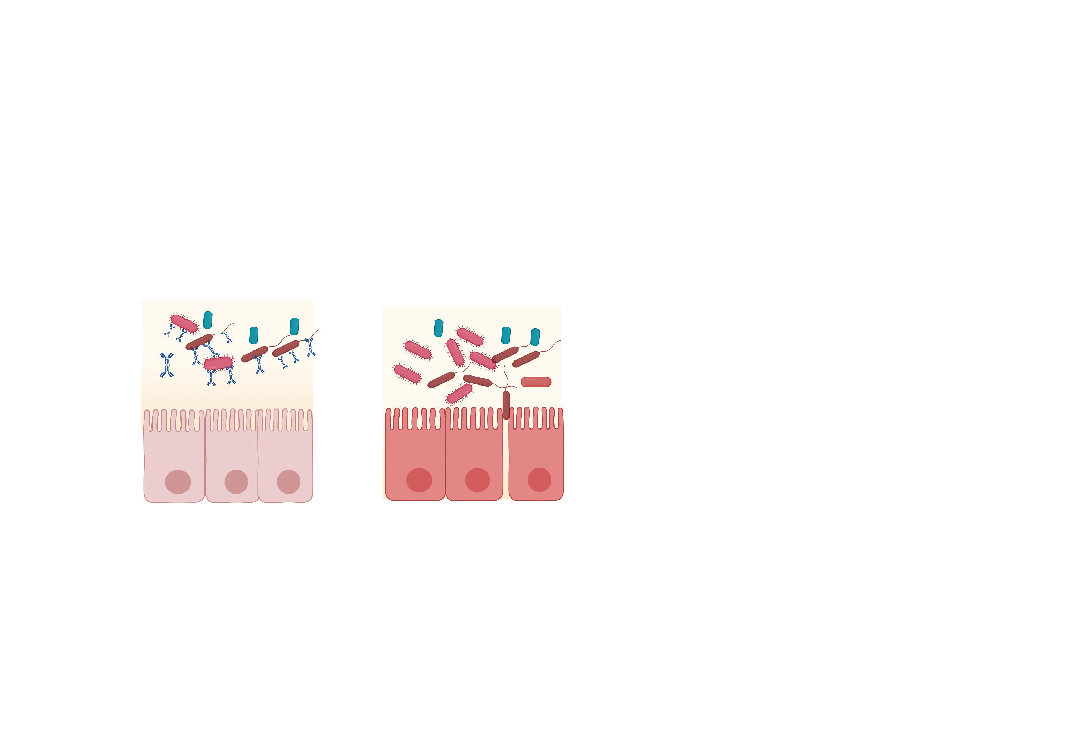
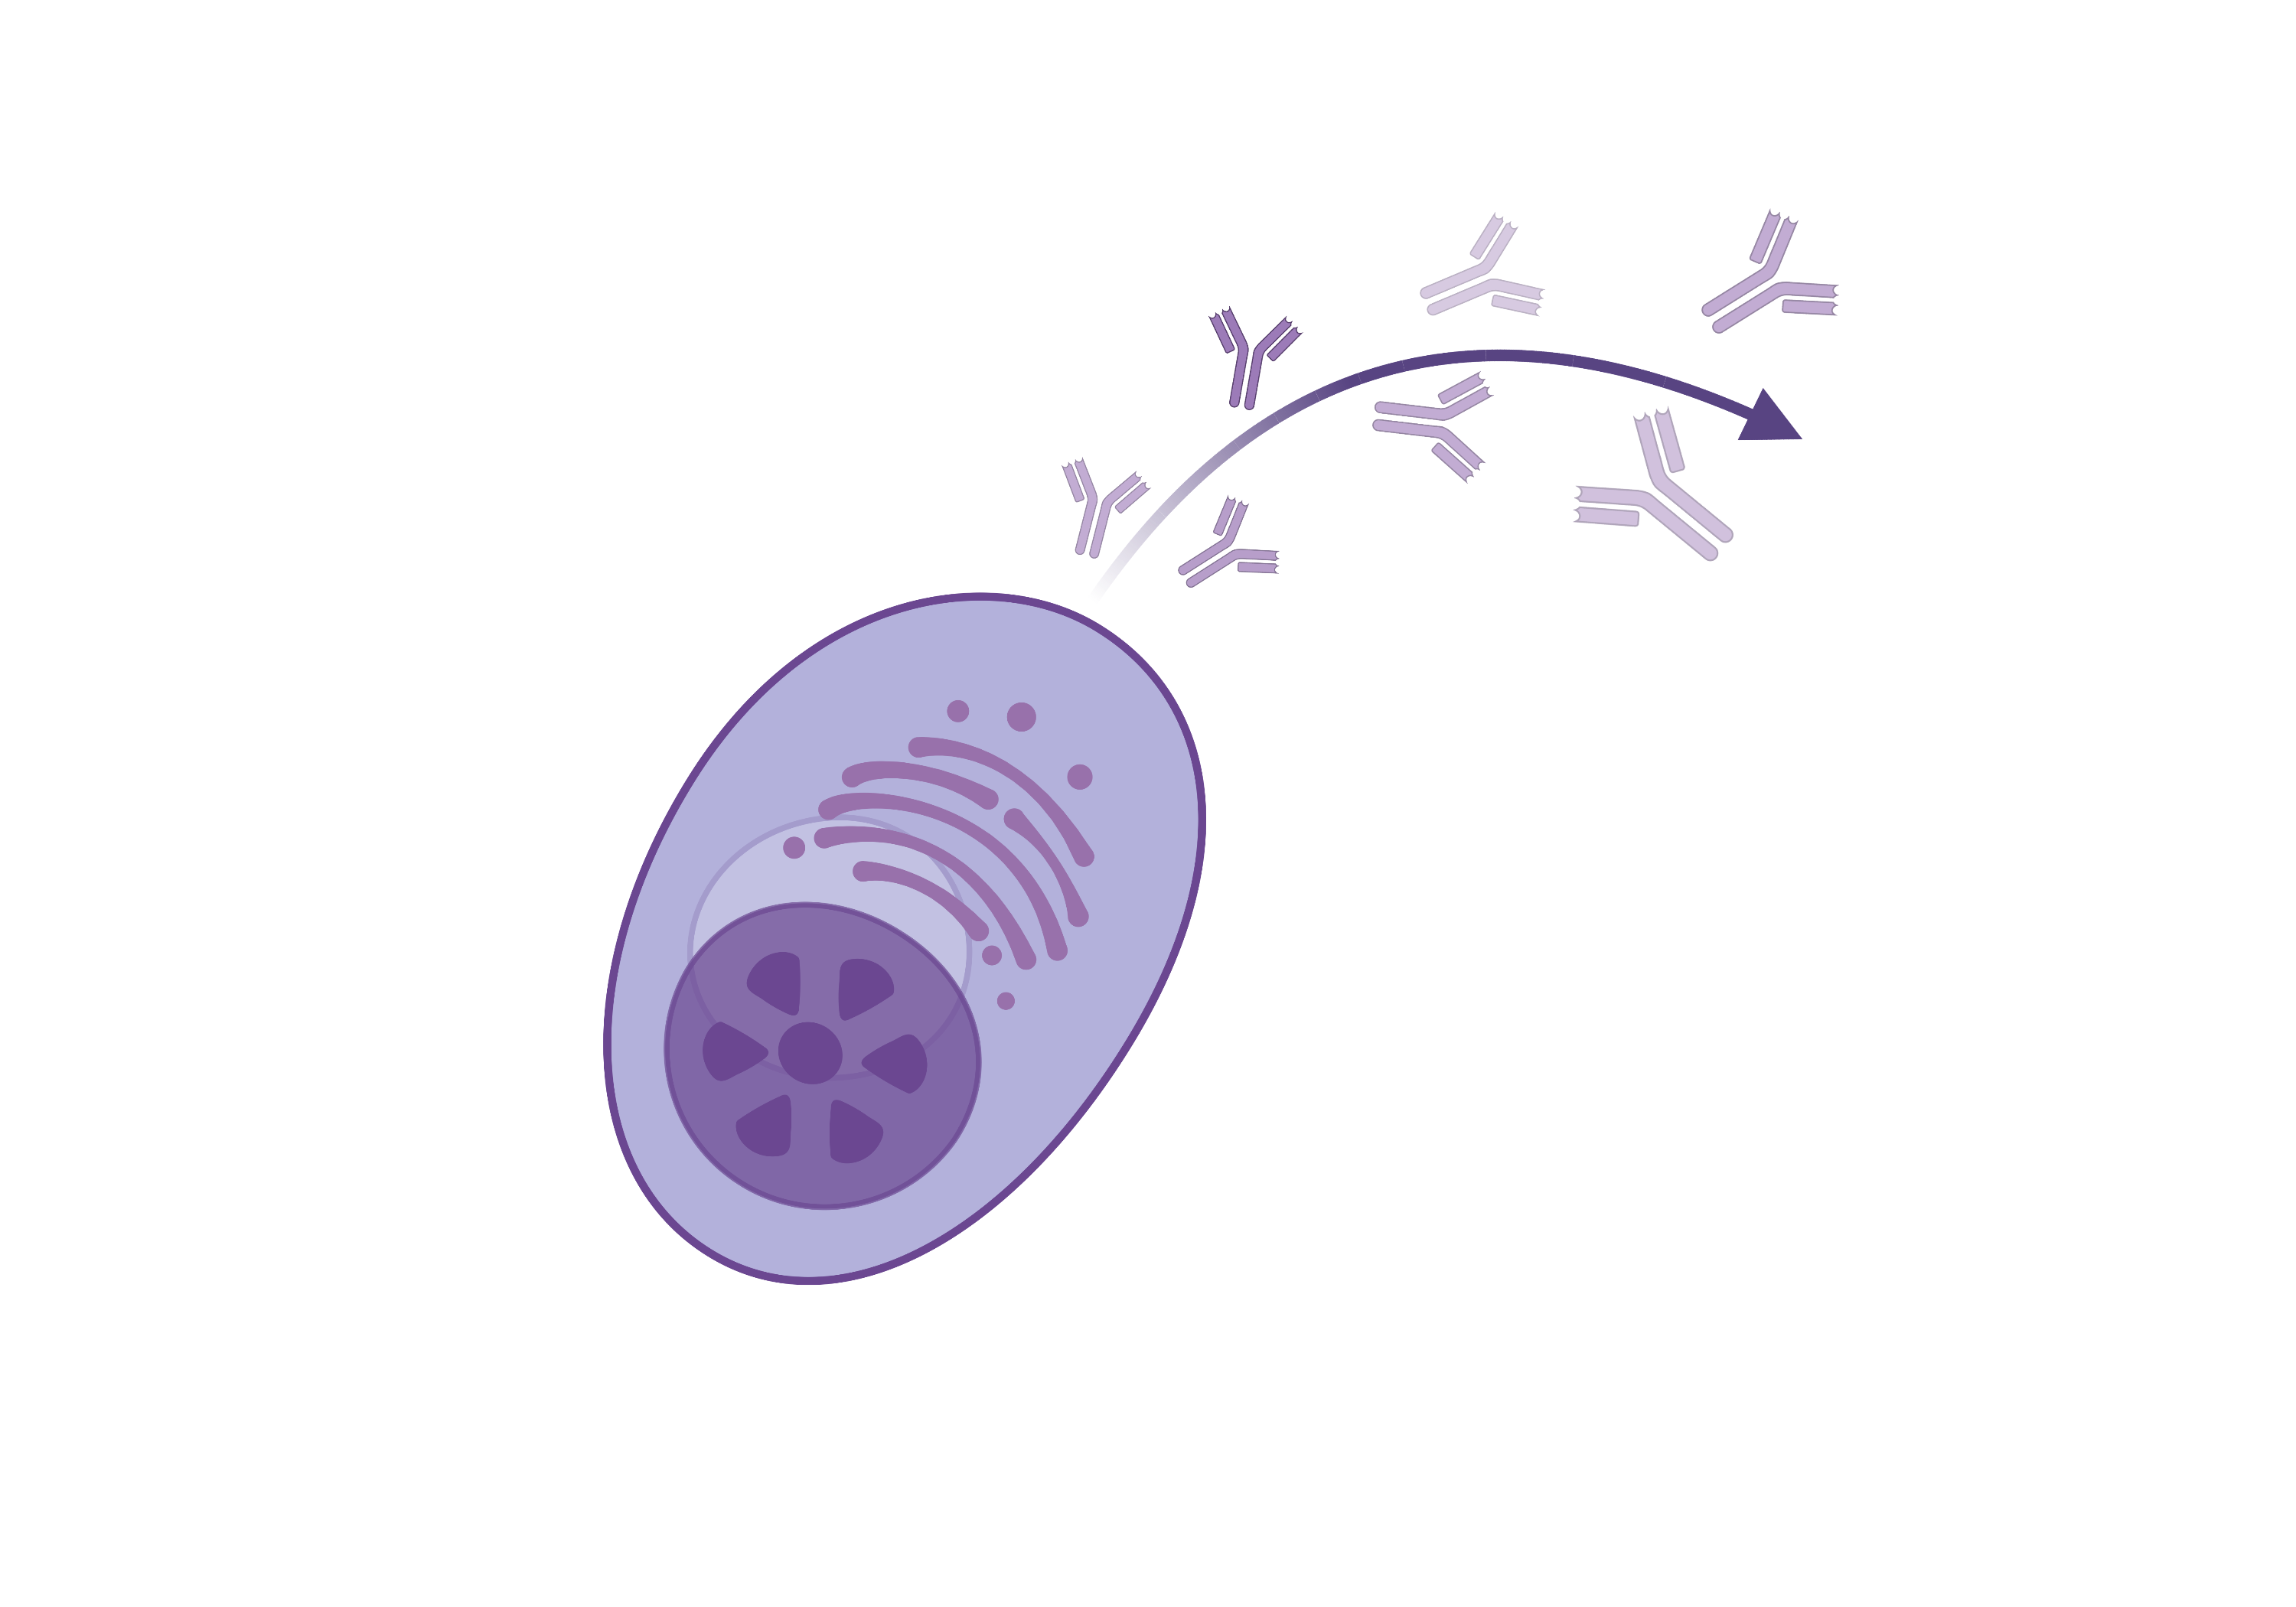
Microbiota as potential biomarkers to understand MS disease mechanisms
Whole community microbiota
IgA-interacting microbiota
IgA
IgA
Bacteria, viruses, fungi,
archae
Prevents generation of pathobionts, maintaining
homeostasis
How is the microbiome potentially linked to MS?
a)
b)
c)
Molecular mimicry and gut dysbiosis in MS evolution (Cree et al., 2016)
Migration of IgA-producing cells
to CNS in MS (Pröbstel et al., 2020)
Decreased IgA interaction in severe MS (Sterlin et al., 2021)

Slide 4


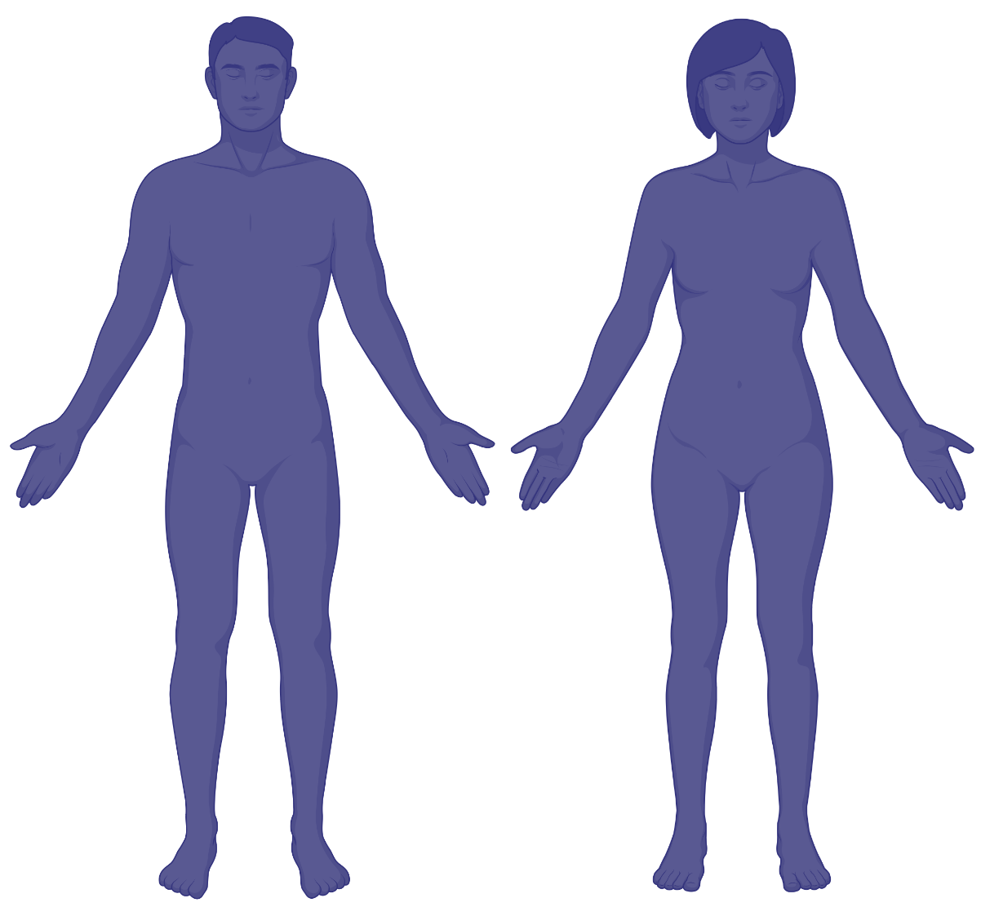
Research Problem: What is the role of the microbiome in disease progression?
IgA
IgA
IgA
Healthy individual
CIS Patient
MS patient
?
How does the whole and IgA-microbiome landscape shift and interact from healthy to early to late stage MS?
Research Objectives
Axis 1
Axis 2
Healthy, CIS and MS patients
IgA-interacting
microbiome profiling
Whole microbiome profiling
Microbial composition, diversity, interaction, function
3

Slide 5
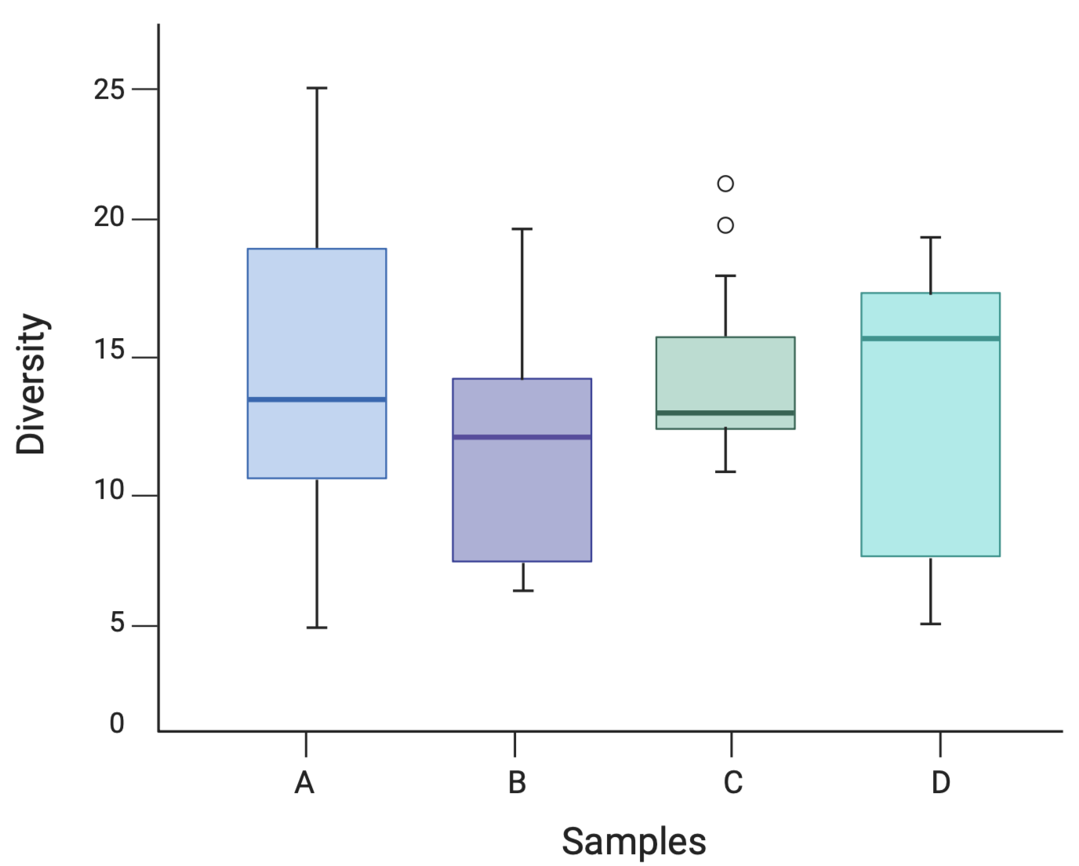



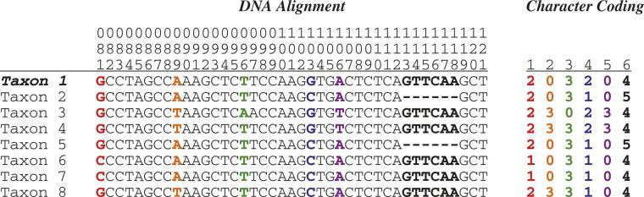
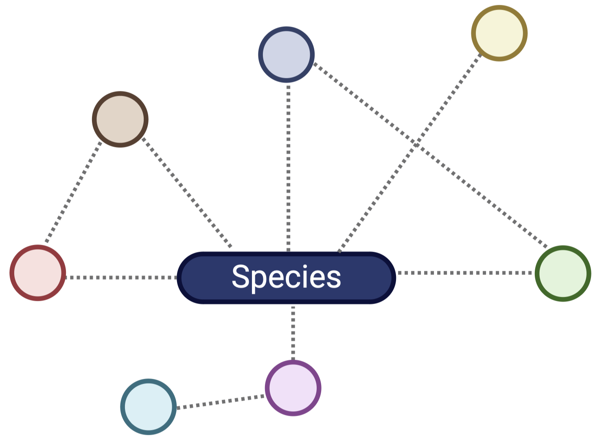

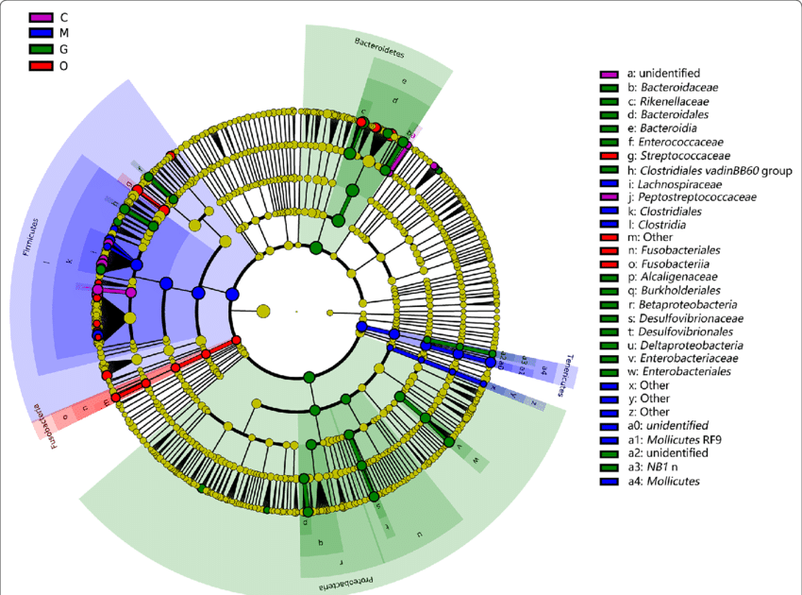
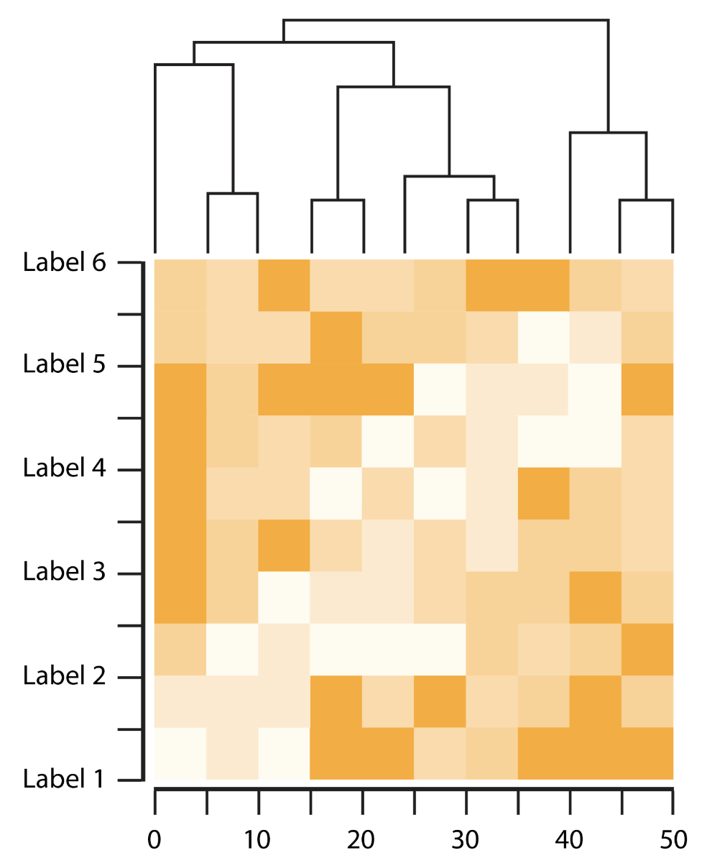

Research Methodology
Axis 1
Whole microbiome profiling
Diversity analysis
FASTQ
Bacteriome and Mycobiome
16S and ITS
sequencing
Taxonomic Assignment
(DADA2)
Healthy subjects
(Control)
Bacterial-fungal
interaction analysis
CIS (Early onset)
Axis 2
IgA-interacting
microbiome profiling
Diversity and interaction analysis
MS (Late onset,
RR and SP)
Sorted IgA+ and IgA-
Bacteriome
Amplicon and shotgun sequencing
(Healthy and CIS samples)
Taxonomic and functional
assignment
Strain level and functional analysis
4

Slide 6
Axis 1 :
Whole microbiome profiling – bacteria and fungal diversity and interaction

Slide 7
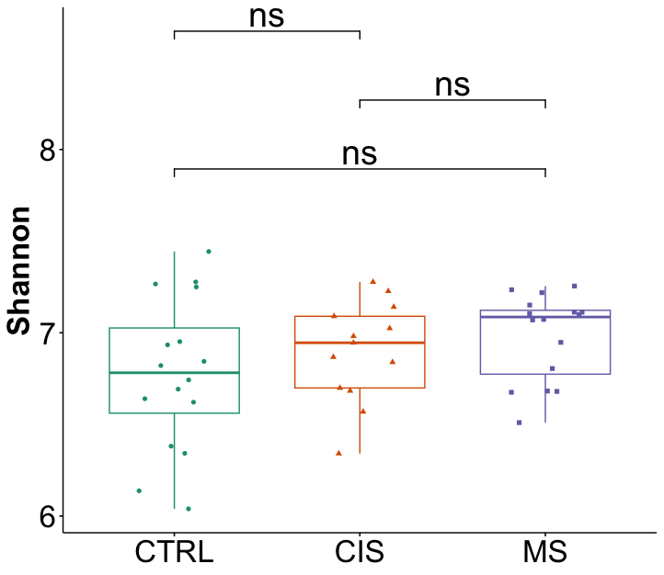
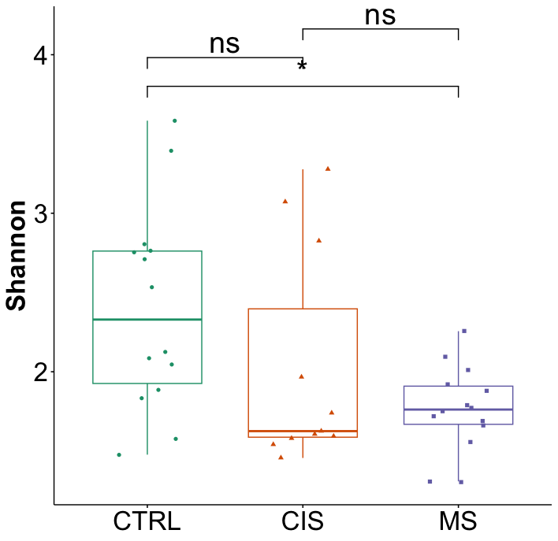
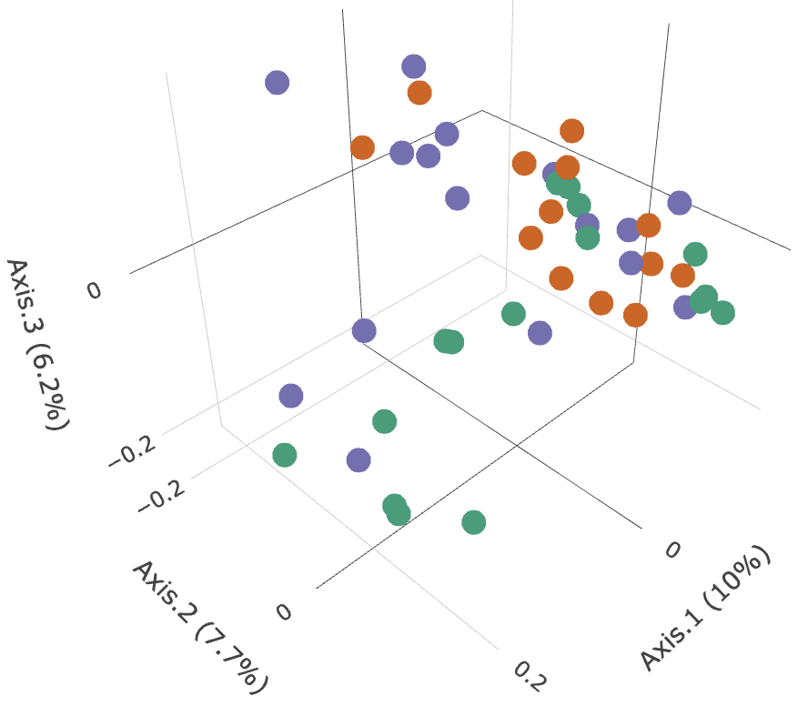
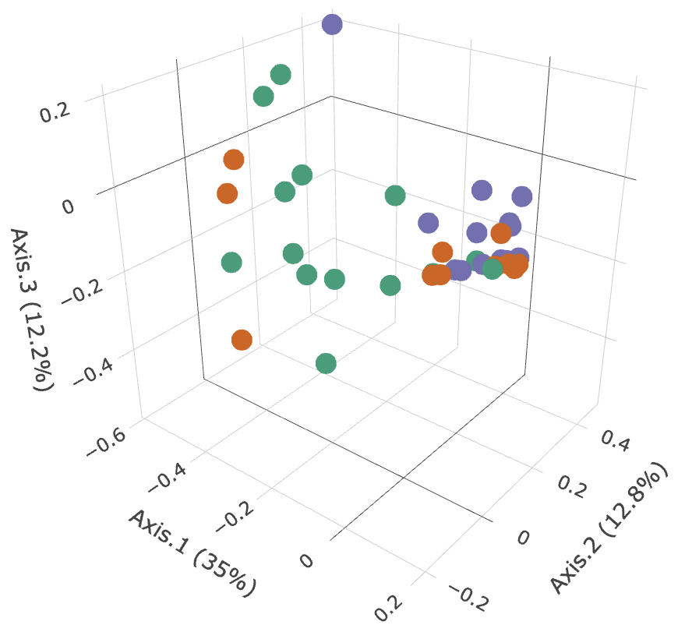
Microbiome characterization of bacteria and fungi through diversity analysis
a)
Wilcoxon
b)
Wilcoxon
Alpha diversity
*
CTRL
CTRL
CIS
CIS
MS
MS
(Bacteria)
(Fungi)
(n = 16)
(n =14)
(n =11)
(n =14)
(n = 13)
Beta diversity
(n = 16)
c)
d)
(Bray-Curtis dissimilarity)
(Bray-Curtis dissimilarity)
CTRL
CTRL
CIS
CIS
MS
MS
(Bacteria)
(Fungi)
PERMANOVA
PERMANOVA
(R² = 0.06161, p = 0.0073)
(R² = 0.11363, p = 0.0077)
Fungi explains more within and between sample variation at different stages of MS compared to bacteria
5

Slide 8
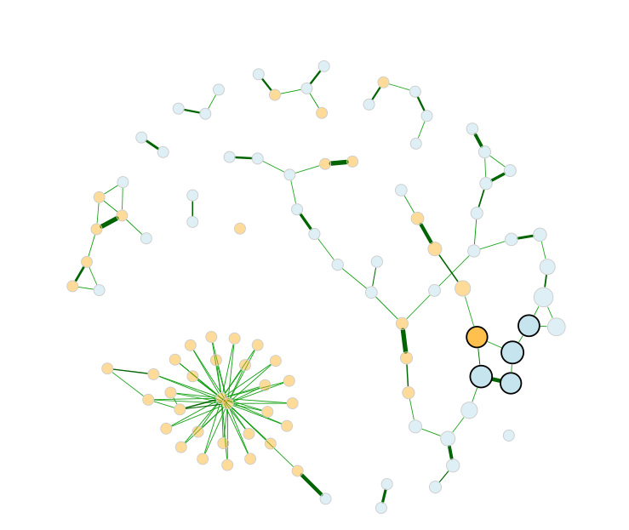
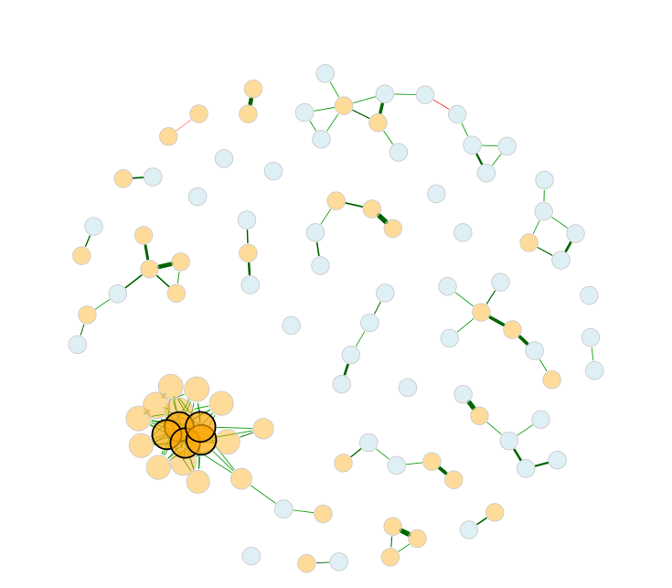
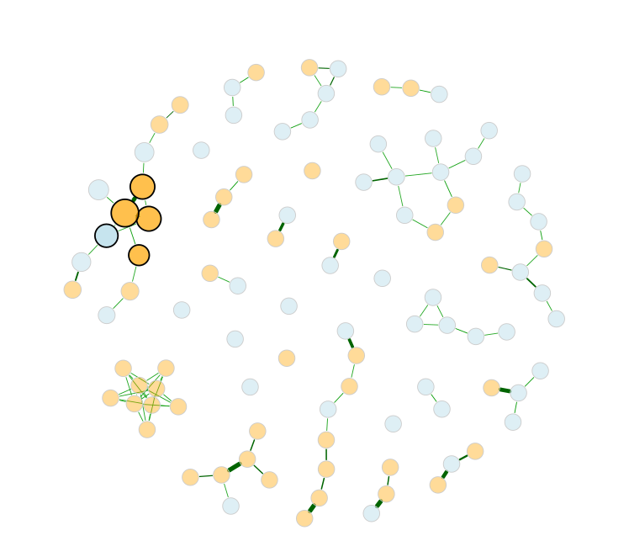
Assessing bacterial and fungal microbial association in CIS and MS state
Control
CIS
MS
Control vs CIS
ARI = 0.069
Control vs MS
ARI = 0.043
ARI = Adjusted Rand Index
0 – Completely random clustering
1 – Similar clustering
_
Estimated correlation
Bacteria
+
Fungi
Altered interaction networks defined by dissimilar clustering and bacteria-fungi associations in CIS and MS
6

Slide 9
Axis 2 :
IgA-bound bacteria profiling – bacterial diversity, interaction, strain genotypes and functional analysis

Slide 10
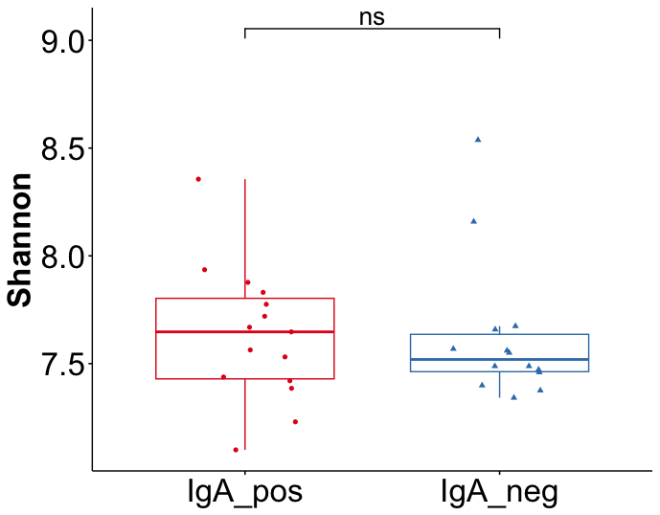
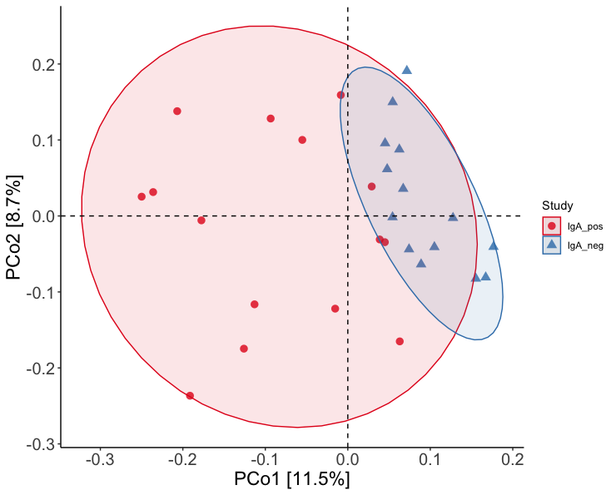
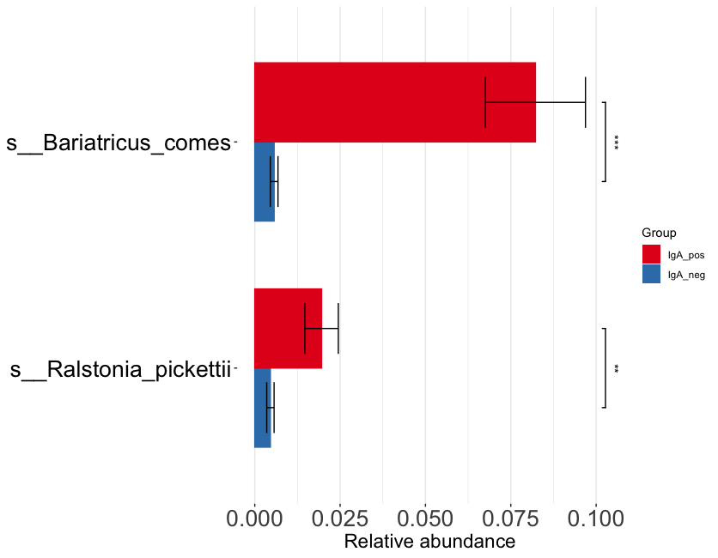
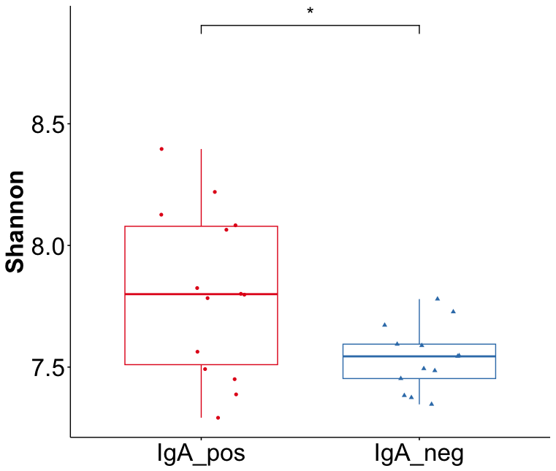
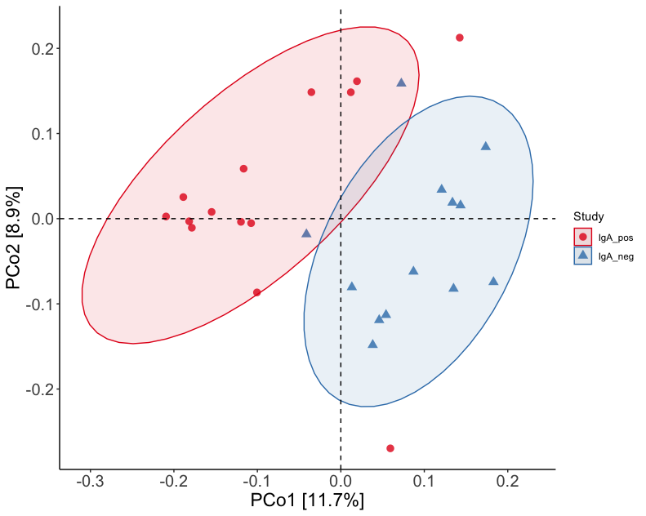
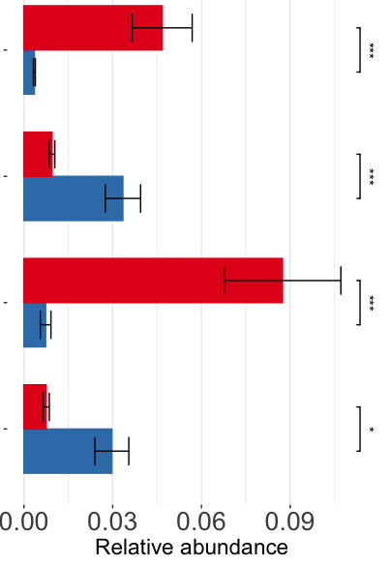
Differences in IgA-bound and IgA-free bacteria in healthy and CIS subjects
CONTROL
Wilcoxon
Bariatricus comes
*
* *
IgA_pos
IgA_pos
IgA_pos
IgA_neg
IgA_neg
IgA_neg
Ralstonia pickettii
*
*
PERMANOVA
(R² = 0.07924, p = 0.0001)
(n =15)
(n =14)
*
Wilcoxon
CIS
Ralstonia pickettii
*
* *
IgA_pos
Anaerobutyricum halii
*
* *
IgA_neg
IgA_pos
IgA_pos
IgA_neg
Bariatricus comes
*
* *
IgA_neg
PERMANOVA
Faecousia sp.
(R² = 0.0811, p = 0.0002)
*
(n =14)
(n =12)
IgA+ and IgA- bacteria potentially exhibit more variation in CIS samples as compared to control
7

Slide 11
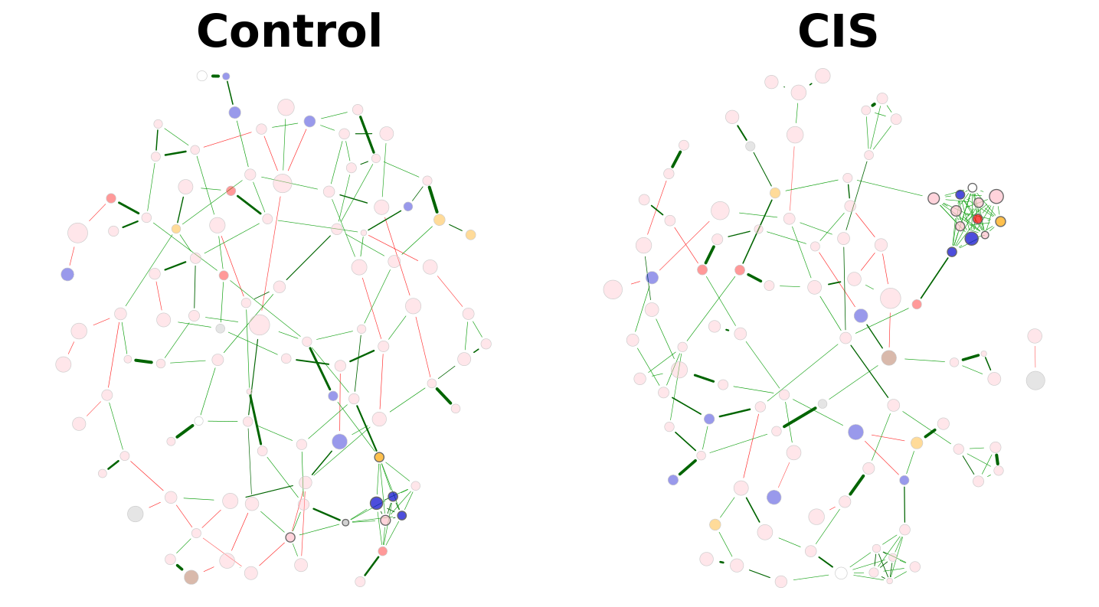
Network analysis of IgA-bound bacteria in control and CIS patients
Control vs CIS
ARI = 0.057
ARI – Adjusted Rand Index
0 – Completely random clustering
1 – Similar clustering
_
Estimated correlation
+
Increased bacterial clustering and edge density in CIS interaction network as compared to control
10

Slide 12
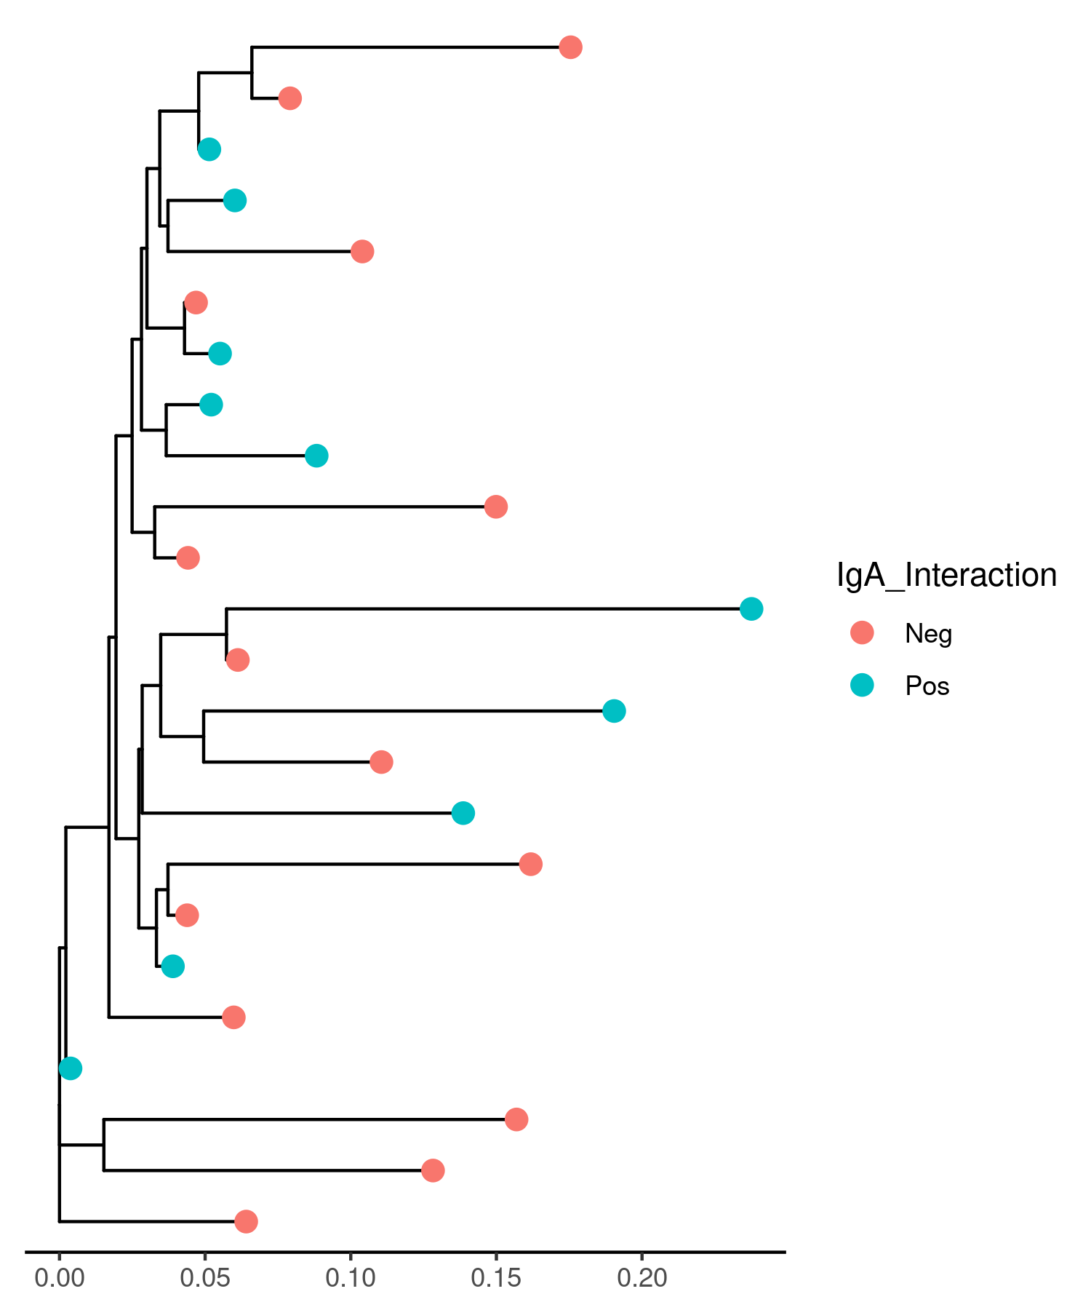
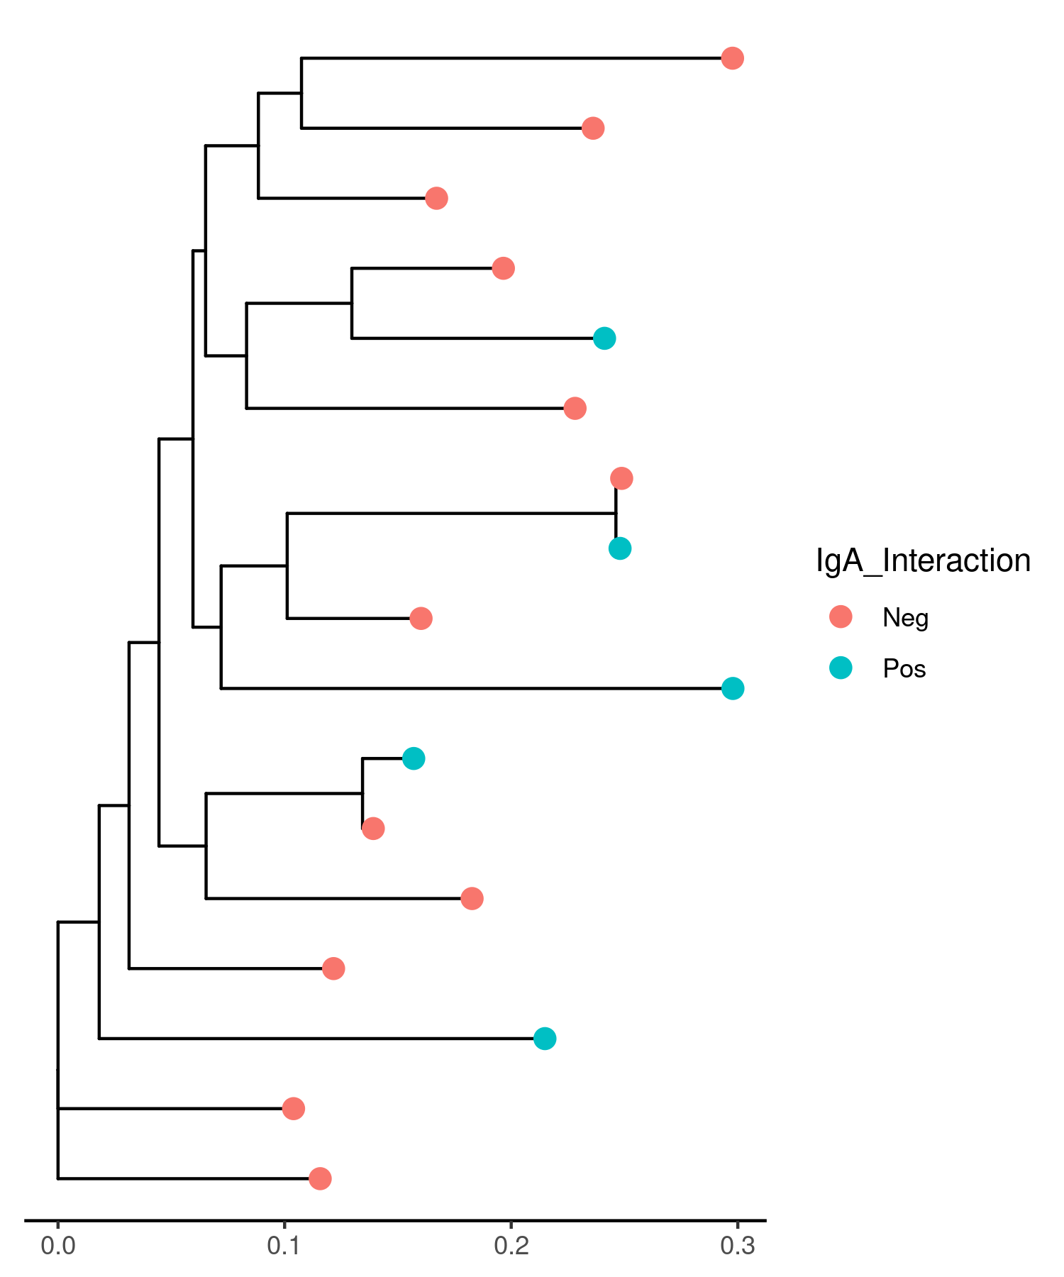
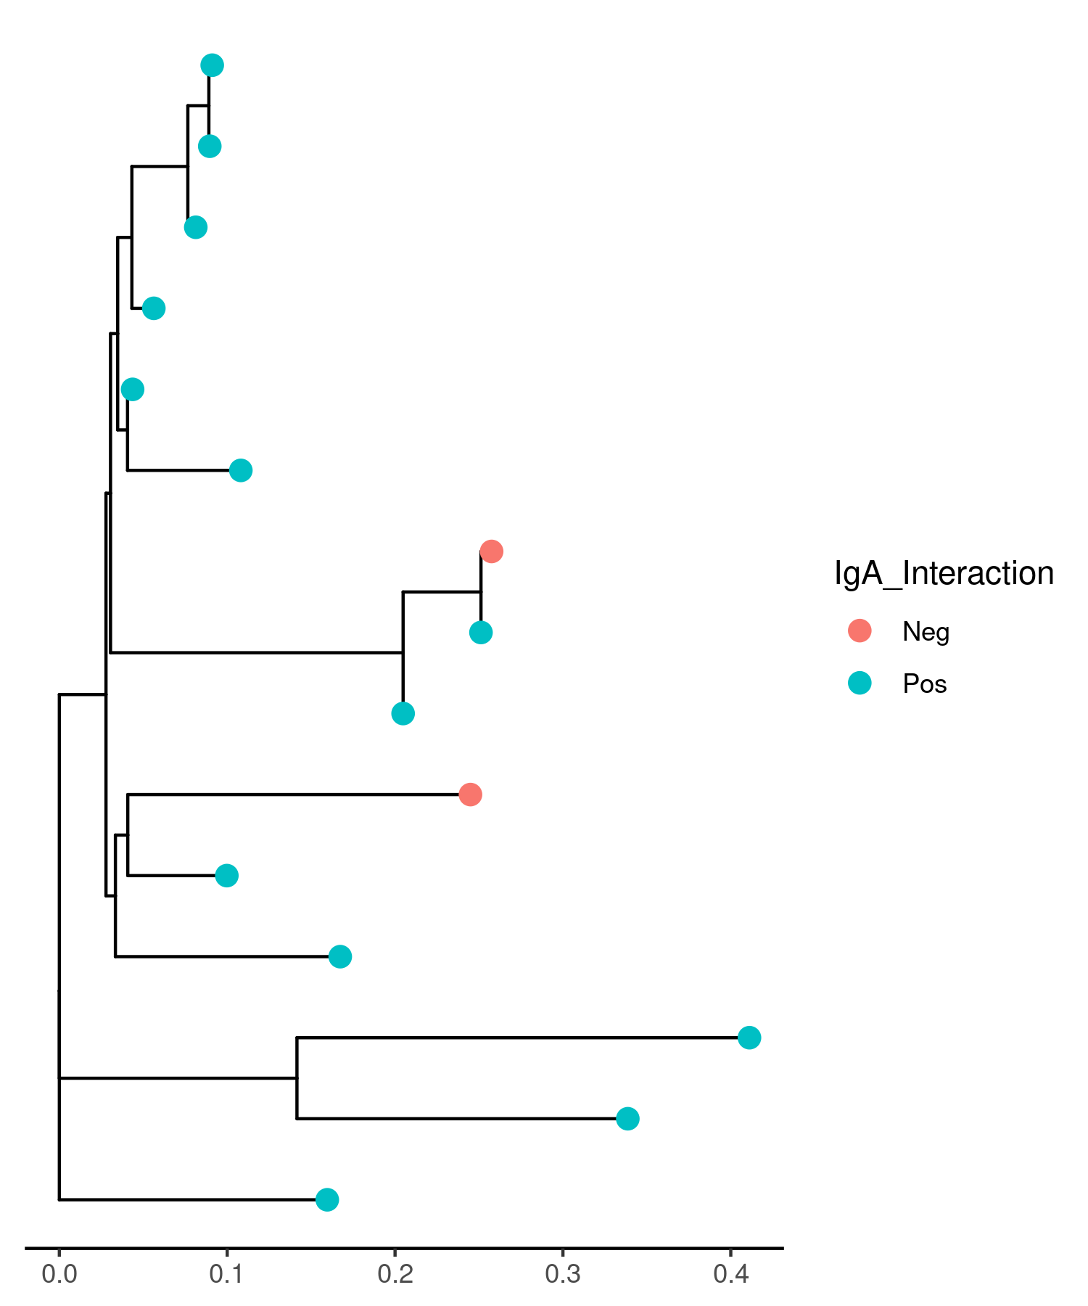
IgA+ and IgA- bacteria strain-level profiling analysis
Blautia wexlerae (most prevalent bacteria in shotgun samples)
Control
CIS
Blautia wexlerae shows increased strain-level genotypic differences in CIS state as compared to control sample
8

Slide 13
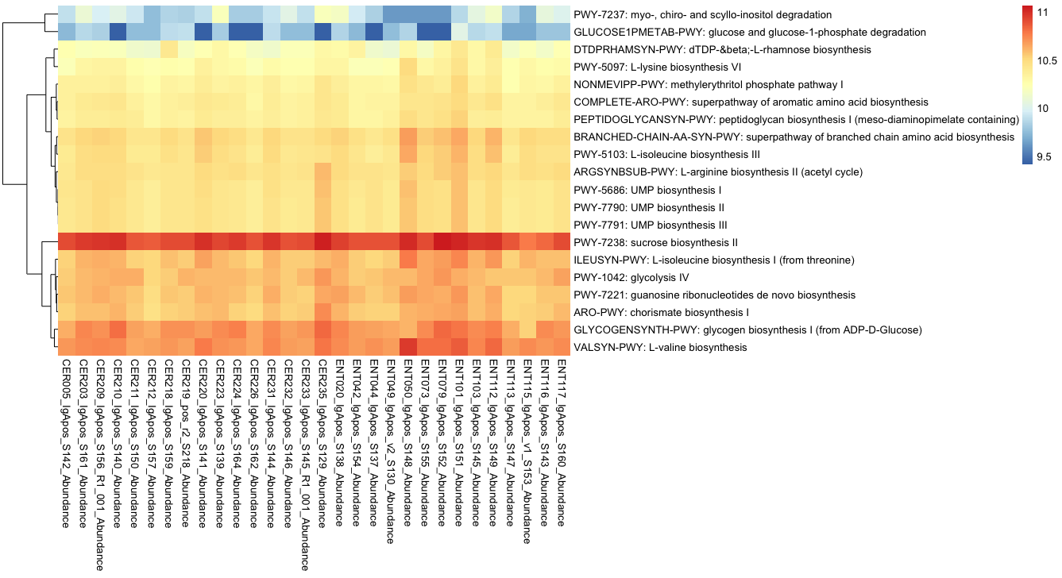
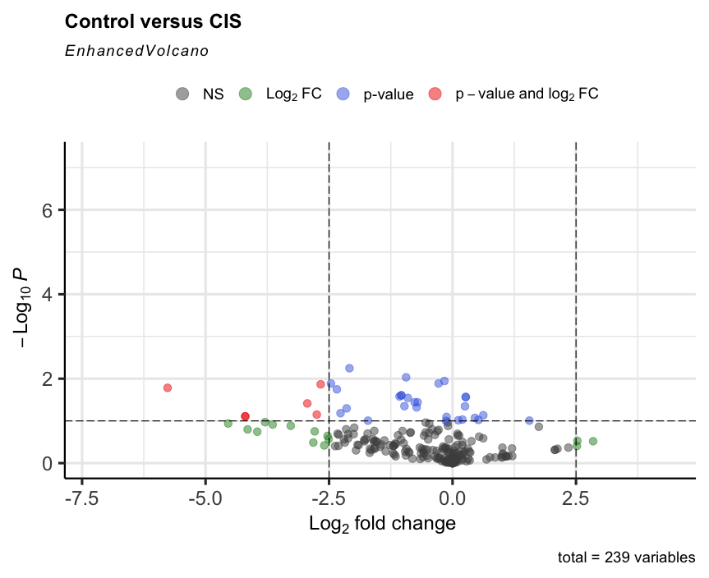


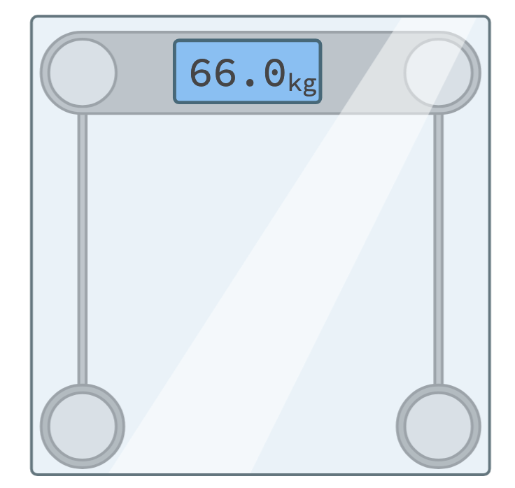
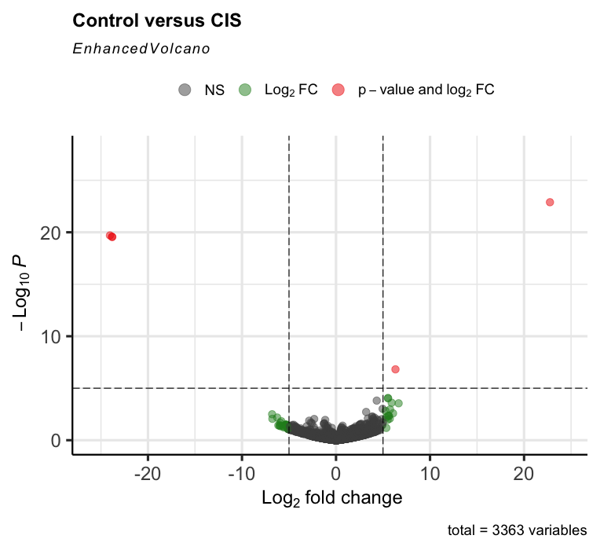

Functional analysis of IgA+ bacteria in control and CIS subjects
a)
Myo, chiro and scyllo –insoitol degradation
Glucose and glucose-1-phosphate degradation
b)
dTDB-%beta;-L-rhamnose biosynthesis
L-lysine biosynthesis VI
Methylerythritol phosphate pathway I
Superpathway of aromatic amino acid biosynthesis
Peptidoglycan biosynthesis I
Branched chain amino acid biosynthesis
L-isoleucine biosyntheiss III
L-arginine biosynthesis II
HEXITOLDEGSUPER-PWY
UMP biosynthesis I
ARGYSN-PWY
UMP biosynthesis II
PWY-7560
UMP biosynthesis III
Sucrose biosynthesis II
L-isoleucine biosynthesis I (from threonine)
glycolysis IV
Guanosine ribonucleotides de novo biosynthesis
PWYO-1586
Chorismate biosynthesis
Glycogen biosynthesis I
L-valine biosynthesis
Control
(n = 32)
CIS
(n = 28)
HEXITOLDEGSUPER-PWY – Hexitol degradation
PWY-7560 – Methylerythritol phosphate pathway II
ARGYSN-PWY – L-arginine biosnythesis
PWYO-1586 – Peptidodglycan maturation
Amino acid biosynthesis and peptidoglycan biosynthesis and maturation pathways are highly abundant in CIS IgA+ bacteria as compared to control
11

Slide 14
Results summary and discussion
a) Fungal microbes are potentially more sensitive indicators of MS-associated gut microbiome changes than bacteria.
b) Altered whole microbiome and IgA-binding bacterial associations reflects community-based pathobiology and antagonism among microbes.
c) Bacteria possibly develop evasive mechanisms such as peptidoglycan structure alterations to prevent IgA targeting
12

Slide 15
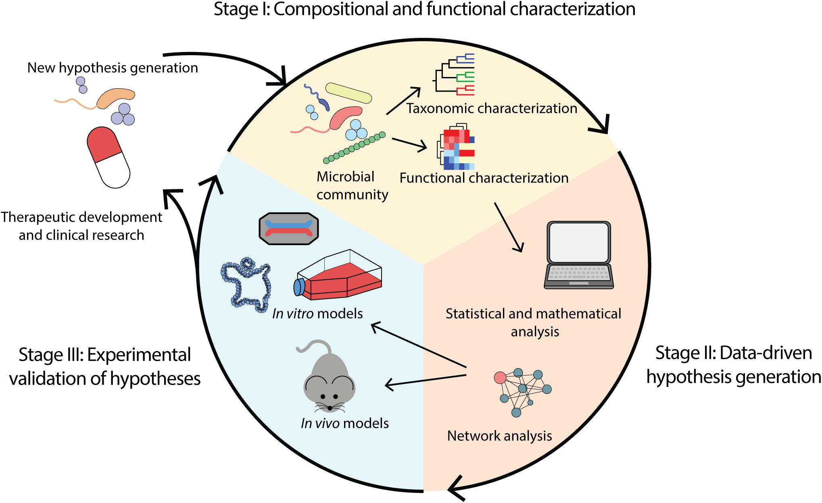
Research Perspectives
✅
Future studies
a) Larger sample size
b) Longitudinal time points
✅
Young et al., 2021
13

Slide 16



Acknowledgements
Prof. Denis Thieffry - Academic Tutor
Prof. Marie Gendrel - Master 2 Coordinator
Prof. Guy Gorochov - Team Leader
Dr. Lejla Imamovic - Project Supervisor
Computational Resources
Dr. Delphine Sterlin - Project Collaborator
Dr. Alicia Moreno - Project Collaborator

Slide 17
Supplementary Data

Slide 18
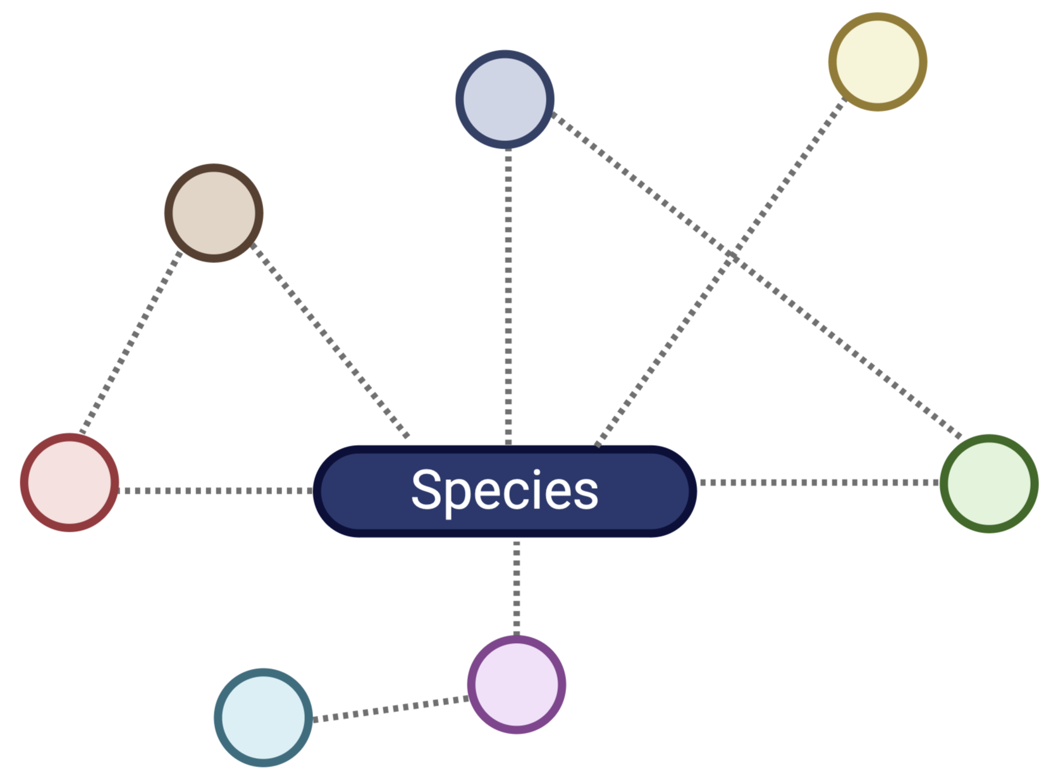
1. Network Theory for Microbial Interaction Characterization
Data Preparation
Network Construction
 | ASV1 | ASV2 | ASV3 | ASV4
S1
S2
Association estimation
(Conditional dependence)
Adjacency matrix construction
Sparsification
Count table
(Association value)
Sample and Taxa Filtering
(10% prevalence threshold)
Network Analysis
(Centrality measures, hubs,
Global network properties)
Zero treatment
(Expectation-Maximization algorithm)
Network Comparison
Permutation tests
(CTRL vs CIS)
(CTRL vs MS)
Normalization
(Centred log-ratio transformation)

Slide 19
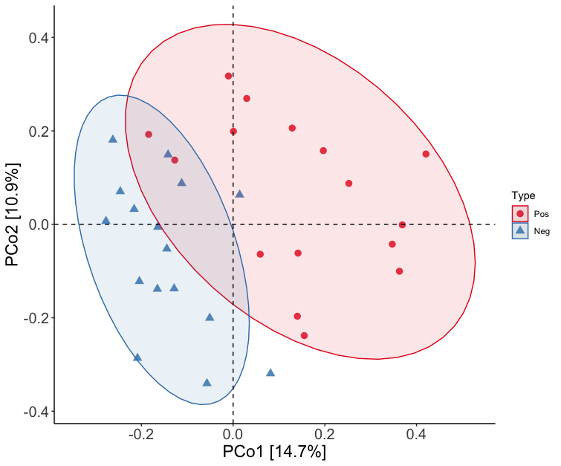
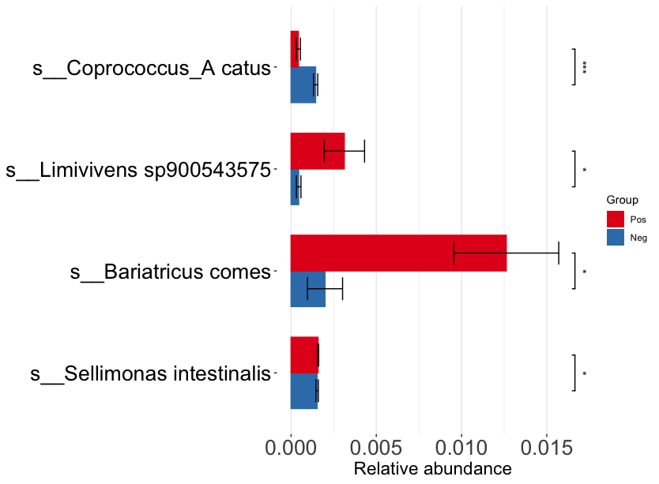
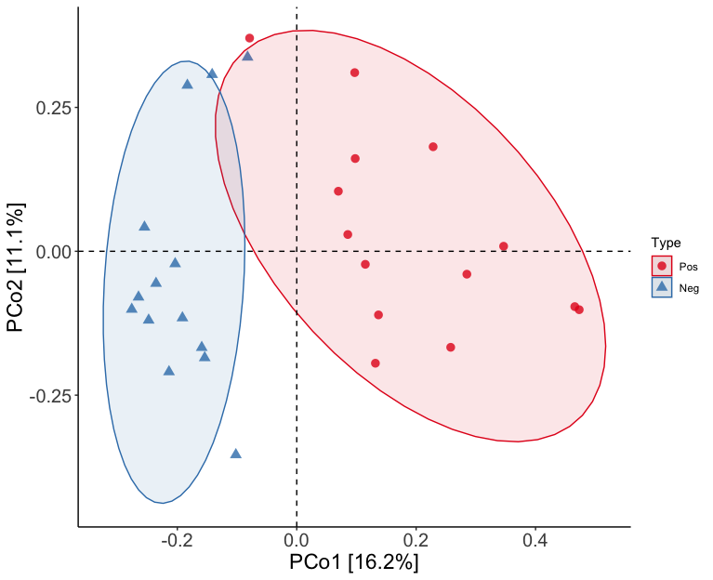
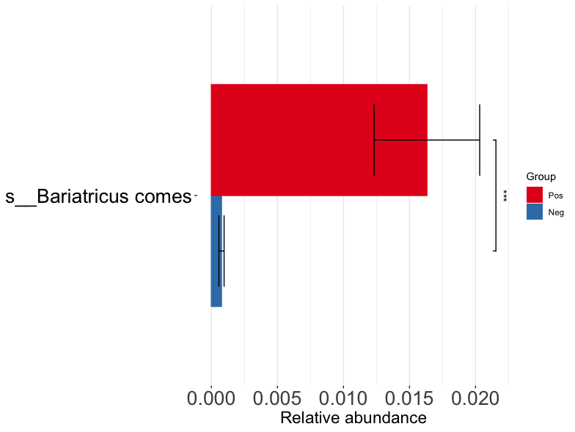
2. Harnessing the power of shotgun sequencing for IgA-bound and IgA-free taxa analysis
CONTROL
b)
a)
Coprococcus_A catus
* *
*
Limivivens sp.
IgA_pos
*
(n =16)
(n =16)
IgA_neg
Bariatricus comes
IgA_pos
*
PERMANOVA
IgA_neg
(R² = 0.09787, p = 0.0001)
Selimonas intestinalis
*
c)
CIS
d)
IgA_pos
Bariatricus comes
*
* *
IgA_neg
(n =14)
IgA_pos
(n =14)
IgA_neg
PERMANOVA
(R² = 0.09787, p = 0.0001)
Shotgun data showed consistency with amplicon data at level of sample variation and differentially abundant bacteria

Slide 20
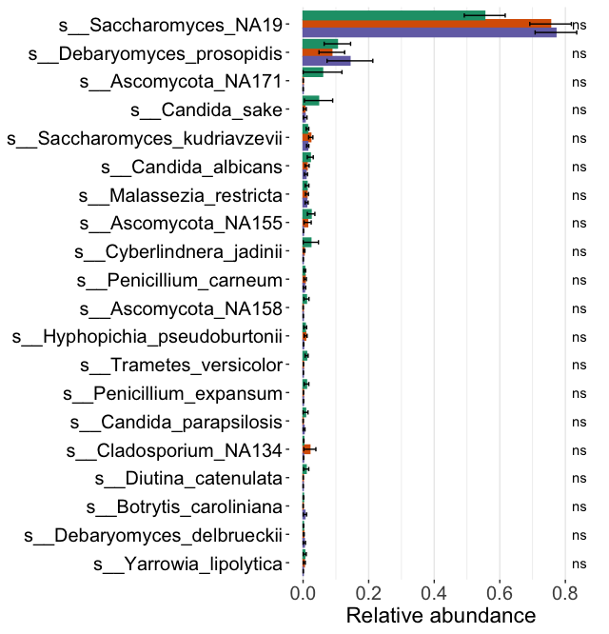
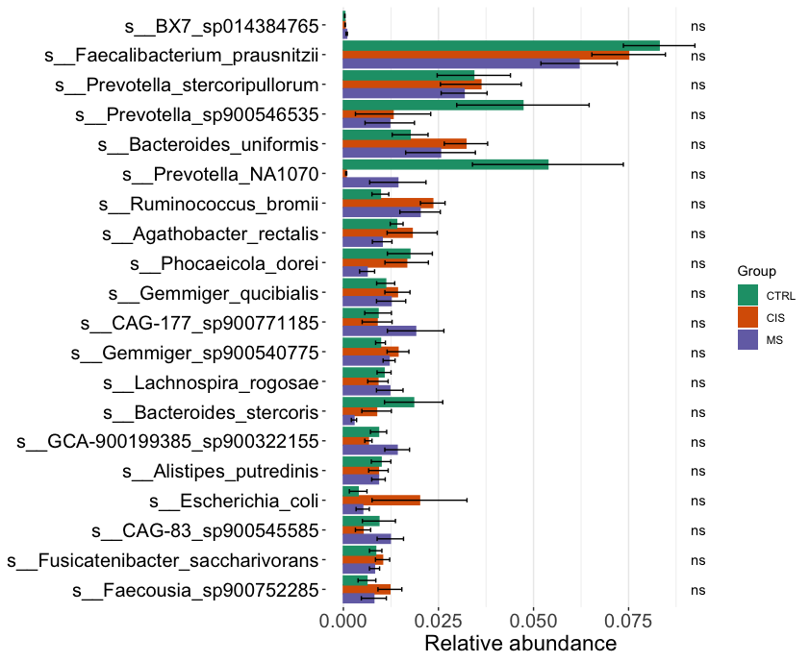
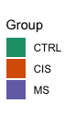
3. Differential abundance analysis of pre-sorted bacteria and fungi in control, CIS and MS

Slide 21
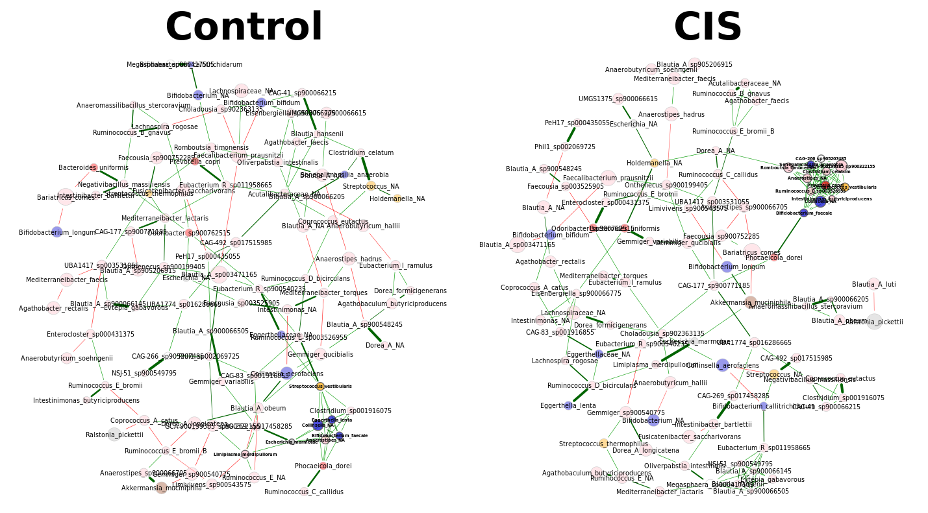
4. Network analysis for IgA-binding bacteria with species labelling in control and CIS subjects

Slide 22


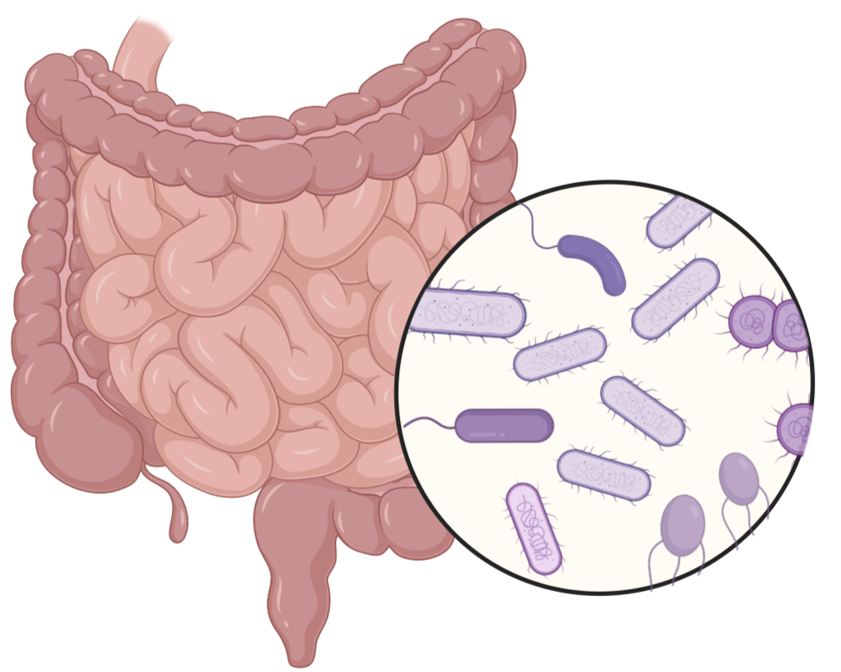

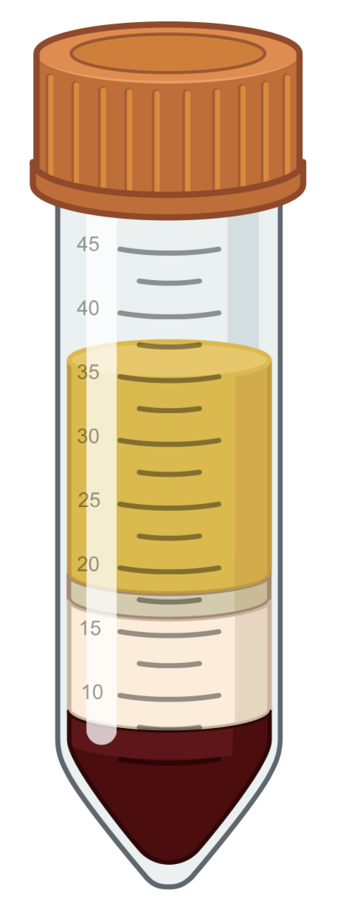


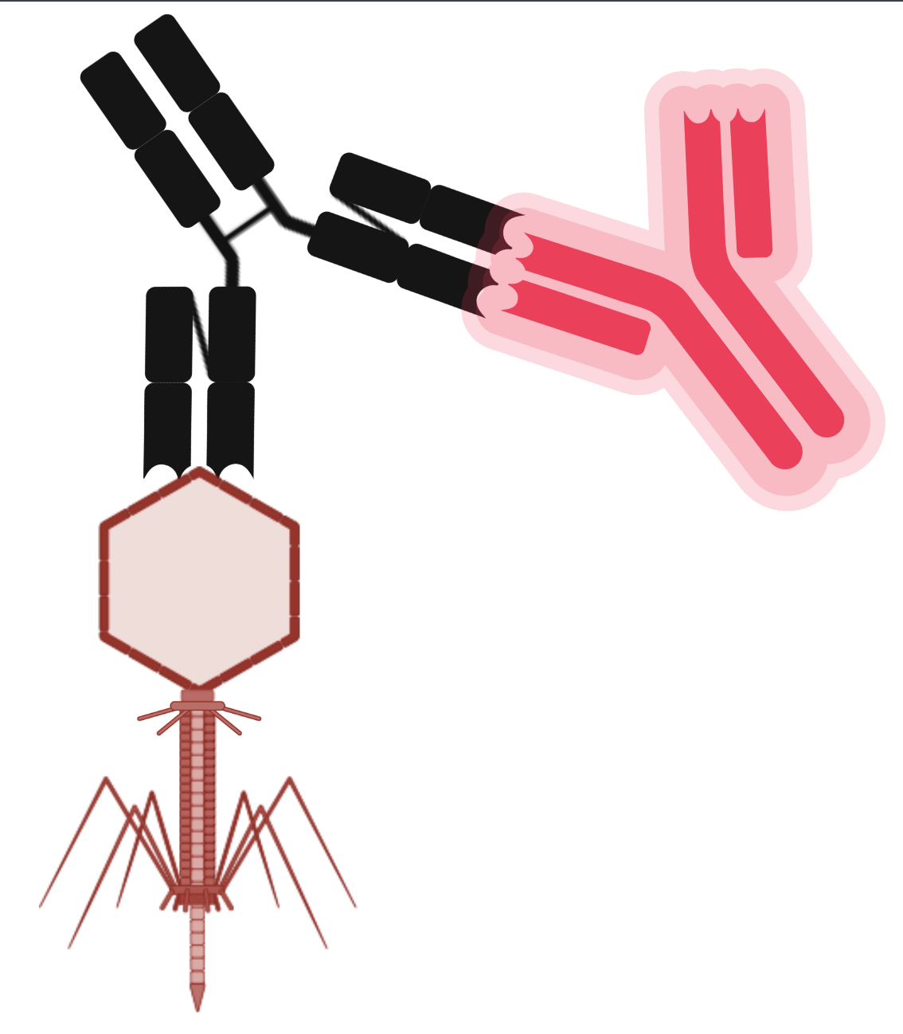
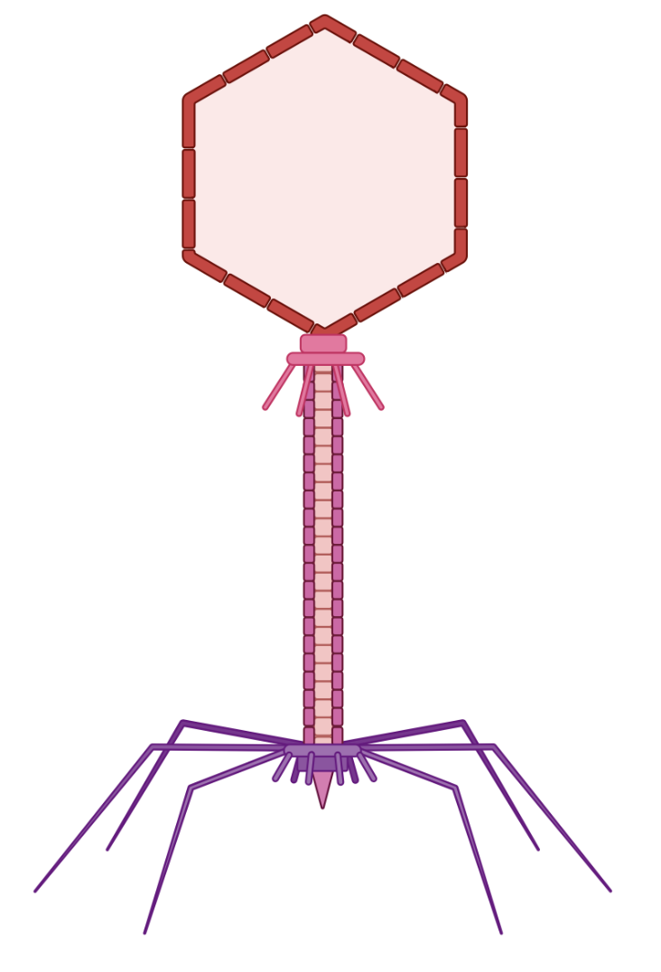



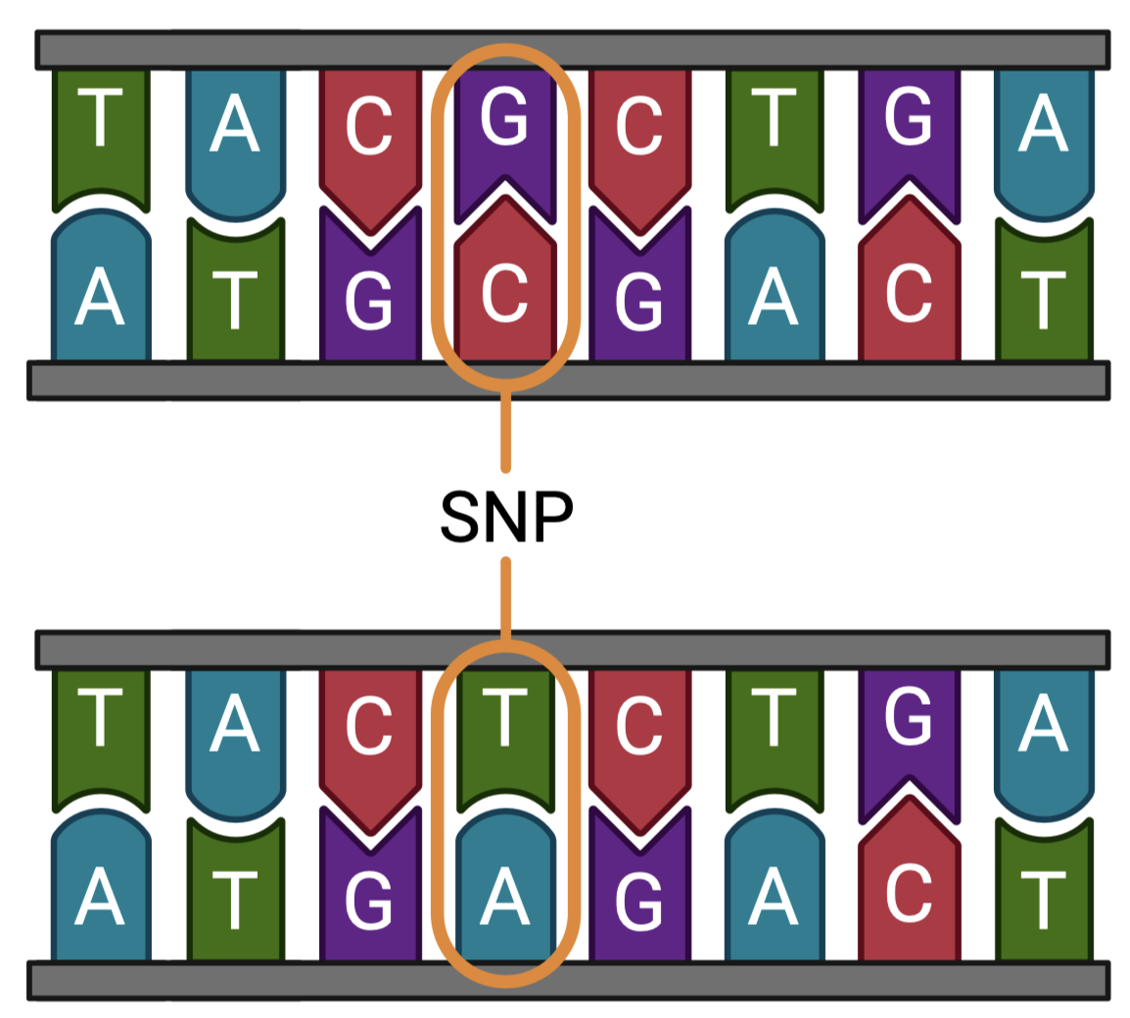
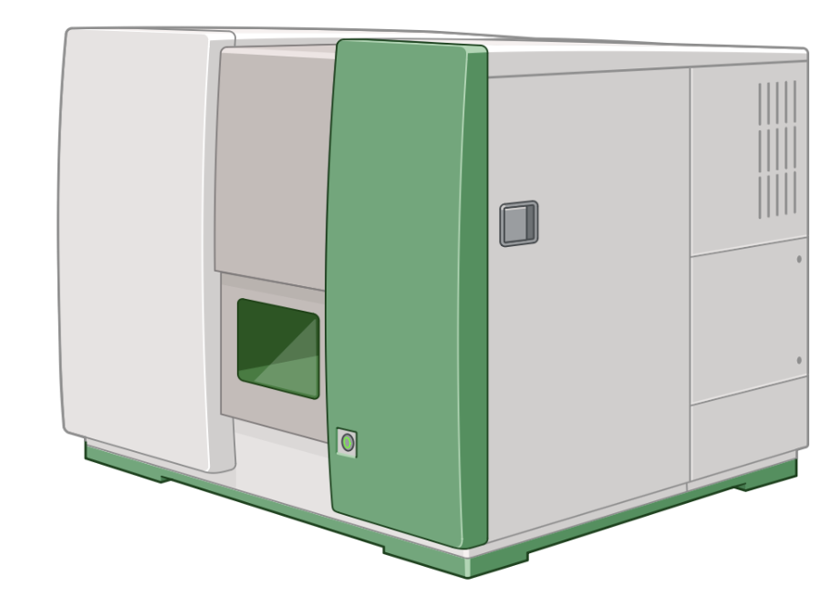

5. Detailed Research Methodology
Healthy donors and donors diagnosed with MS (CIS)
FASTQ
FASTQ
FASTQ
Amplicon sequencing data
Shotgun whole genome data
Virome data
(Illumina MiSeq 2 X 300bp)
(Illumina Novaseq 2 X 250bp)
(Illumina Novaseq 2 X 250bp)
Faecal sample collection
FASTQ
Library preparation and sequencing
Sample Filtration and Concentration
Amplicon sequence variant inference (DADA2)
Reference-based taxonomic classification (MetaPhlan)
and functional profiling (Humann)
Sorting
Viral genome assembly
GTDB
IgA+ Bacteria or Phage
Bacterial or viral suspension
Taxonomic classification using curated databases
(GTDB, SILVA, UNITE)
IgA Antibody labelling
Strain-level profiling (Strainphlan)
Identifying viral contigs
Flow cytometry
ASV_NA1
ASV_NA2
ASV_NA3
ASV_NA4
DB
Sequencing
Clustering unclassified ASVs at 97% similarity
Cell sorting (IgA+, IgA-)
Strain-sharing inference
(StrainPhlan)
Host and virome
Taxonomic profiling

Slide 23


6. Bacterial and fungal core microbiome analysis (amplicon data)

Slide 24

7. Bacterial core microbiome analysis in shotgun samples

Slide 25



8 . Multiple sclerosis : mechanism of action
A heterogenous autoimmune demyelinating disorder of the central nervous system.
Around 2.8 million people are estimated to live with MS worldwide (Walton et al., 2020)
(https://www.nyp.org/healthlibrary/diagnosis/document/zm6056)
(Höftberger et al., 2022)

Slide 26



9. Exploring IgA+ bacteria to identify differences in healthy and CIS subjects
Amplicon data
Shotgun data
a)
b)
(Wilcoxon)
c)
CTRL
CIS
CTRL
CTRL
CIS
CIS
PERMANOVA
PERMANOVA
(R² = 0.04922, p = 0.1126)
(R² = 0.04019, p = 0.2232)
(n = 13)
(n =14)
IgA+ bacteria do not show variation within and between healthy subjects and early-onset MS patients
9

Slide 27

10. Multiple sclerosis features four distinct clinical stages
a) Preclinical Radiologically Isolated Syndrome (RIS)
b) Clinically Isolated Syndrome (CIS)
c) Relapsing - Remitting Multiple Sclerosis (RR)
d) Secondary Progressive Multiple Sclerosis (SP)
Few treatment options available for progressive MS
(Baecher-Allan et al., 2018)

Slide 28
11.Research Methodology
Experimental phase
(IgA Healthy
and CIS samples)
FASTQ
FASTQ
Amplicon sequencing data
Shotgun whole genome data
16S sequencing
FASTQ
Sorted IgA+
And IgA-
Bacteriome
Amplicon sequence variant inference (DADA2)
Healthy subjects
(Control)
Shotgun sequencing
(Healthy and CIS samples)
Reference-based taxonomic classification (MetaPhlan)
Taxonomic classification using curated databases
(GTDB, SILVA, UNITE)
CIS (Early onset)
Pre-sorted
Bacteriome
16S sequencing
Conversion of taxonomic names to GTDB format
Clustering unclassified
ASVs at 97% similarity
Mycobiome
(Fungi)
MS (Late onset,
RR and SP)
ITS sequencing
Diversity analysis
Diversity analysis
Strain-level profiling
(StrainPhlan)
Functional profiling
(Humann)
Network analysis
4

